Slide 1
A Magical Journey from Context to Code
Practical
Open Source North 2025!
Notes:
I am just a GUY, trying to keep up with TECHNOLOGY, looking for a PROBLEM to SOLVE.
Hi, my name is Torey Lomenda. I am local to the Twin Cities and currently am a VP of Solution Architecture & Delivery for Improving MN. Improving is a software development, consulting, and training company with 20 offices around the world providing "all-shore consulting service" options to our clients (onshore, nearshore, offshore)
Today, I am going to take you on a magical journey OR "at the very least" a practical solution architect's journey on adding context to code to build software that works. I hope to keep this fun while sharing tips & techniques, as well as ways of learning & experimenting I consider beneficial. At the end, I will share a link to my GitHub repos that is packed with diagrams, code, dev-tools, and a dockerized playground for you to use.

Slide 2
Building software that WORKS, through a story you CONNECT with, using solution methods to GUIDE delivery.
A Solution Journey
Notes:
I hope you take away from the walkthrough and demo that learning through a journey of "building software that WORKS, through a story you CONNECT with, using solution methods to GUIDE delivery" is worthwhile.
The real world might be "more complex" than what I talk about today, but the methods I highlight, with practice, imagination, and creativity can lead to iteratively delivering higher quality code as part of your SDLC (software development lifecycle).
Normally, I like to keep things conversational, but I want to do my best to stick to the narrative and not get too far off-track. I hope you stick with me on this lighthearted journey to better software 😃

Slide 3
How it Started
From Tutorial to Playground
Notes:
Where it Started
Before jumping in, I want to take a step back and reflect on where this all started.
This provides A GLIMPSE into how I Learn, Experiment, and Apply Software Methods and Technology

Slide 4
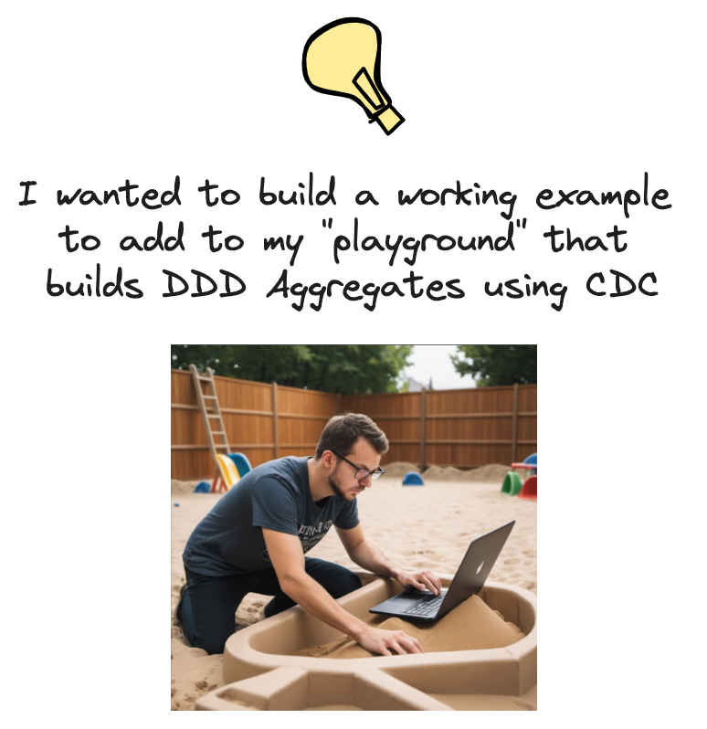
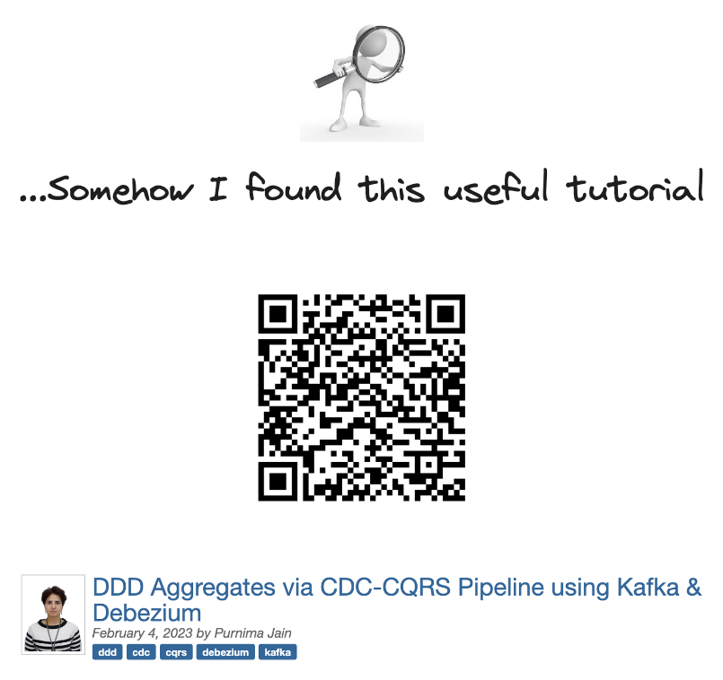
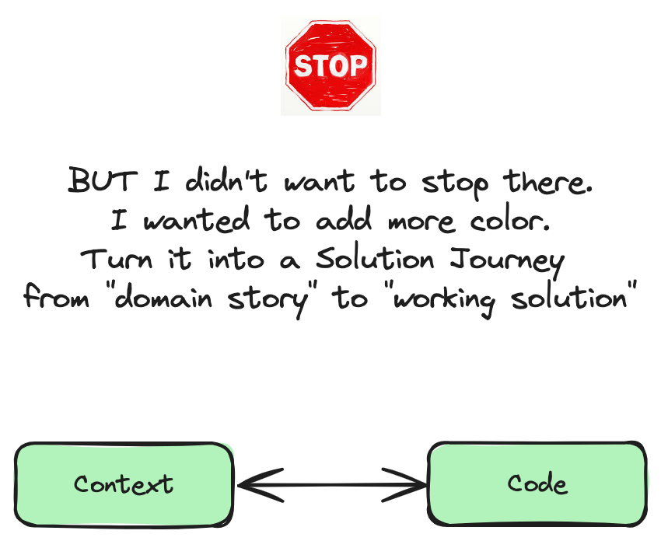

DDD Aggregate --> A cluster of related domain objects (entities and value objects) that are treated as a single unit for consistency
and persistence purposes.
CDC ---------------> Change Data Capture is a technique used to identify and capture data changes (inserts, updates, and deletes) in a database. These changes are made available for downstream processes like building DDD Aggregates
CQRS -------------> Command, Query Responsibility Segregation. Separates read and write operations for
flexibility, performance, scalability, and security.
Kafka -------------> Combines messaging, storage, and stream processing to build real-time data pipelines
Notes:
As a consultant part of the job is keeping up with technology trends and applying them to client solutions as needed. So, I try and remain curious and carve out time the best I can to better understand where I can apply them.
As a Solution Architect, finding pragmatic ways to apply methods, tools, and technologies is a constant driver in my work.
Recently, this led me down a learning path of finding ways to work with domain model "aggregates" and related ”building blocks" within microservices and event-driven architectures. I stumbled on this nice tutorial with all the tech buzzwords I was looking for in building a modern distributed system.
It had Aggregates, it leveraged Change Data Capture in a database, it implemented the CQRS pattern separating read & write operations, and Kafka was used as the defacto standard for operational data streaming. It was a good start - but like with many tutorials what I learned quickly faded - which does not take a lot these these days ☺
However, by adding color with a relatable story and using proven design methods, I was able to retain what I learned. The tutorial has evolved into a well-designed, feature-rich Docker playground "system" that remains a powerful learning tool for ongoing experimentation and practice.
I want to share this "context to code" journey with you, today.

Slide 5
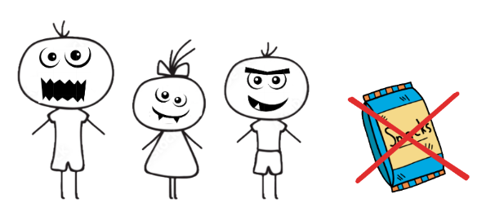
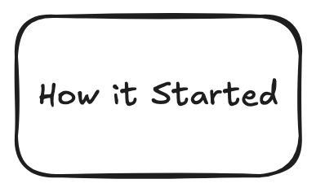
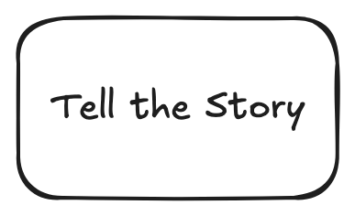
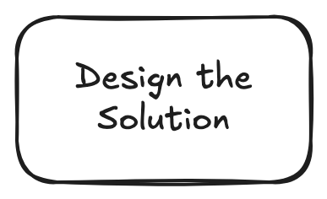
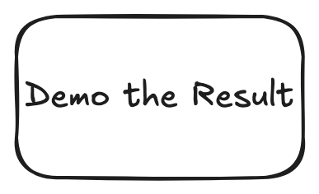
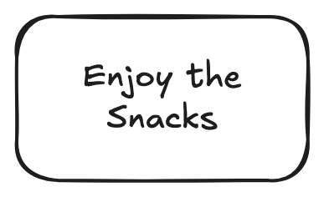



Notes:
Telling the Story
My relatable story involves a wizard and keeping children happy with snacks.

Slide 6
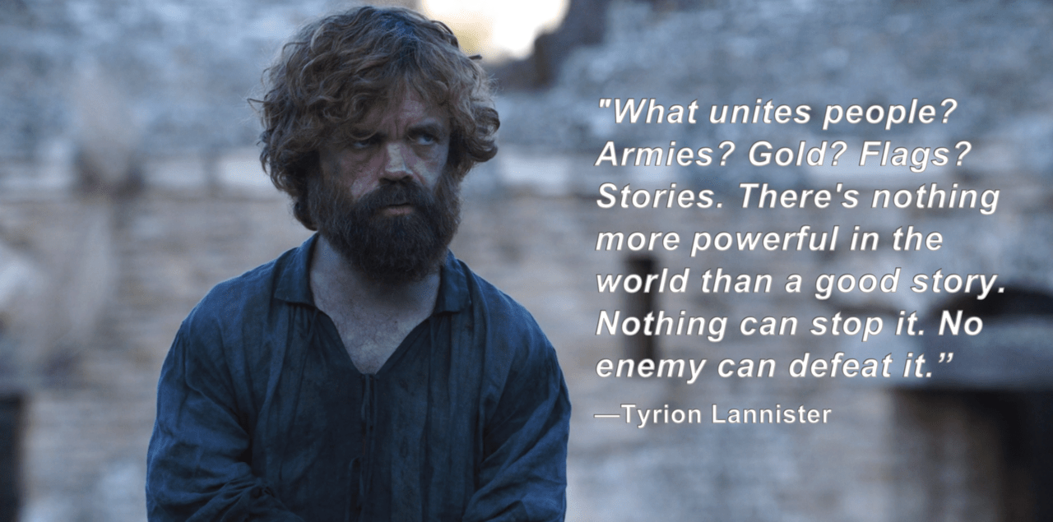
Tell the Story
(Better OUTCOMES when you CONNECT with the Story)
Notes:
Telling a good, relatable story you CONNECT WITH can result in better OUTCOMES.
There is nothing more powerful in the world than a good story.
A Good Story helps me retain information, so concepts stick AND It can align solution delivery teams working towards a common goal.

Slide 7
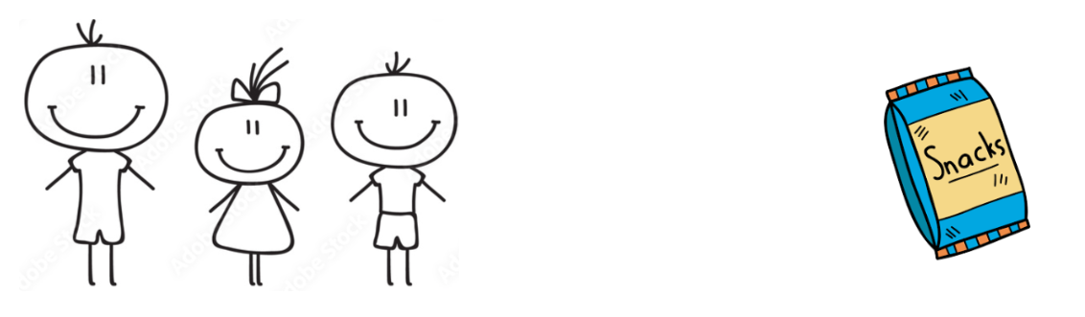
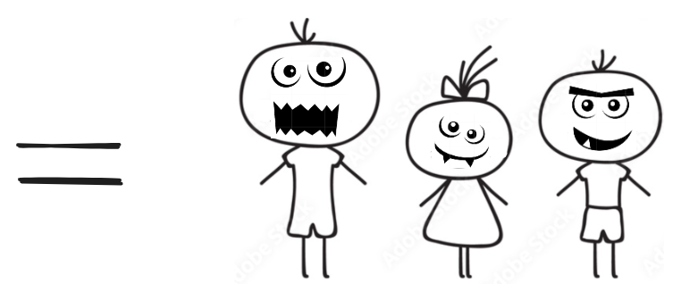
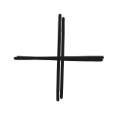
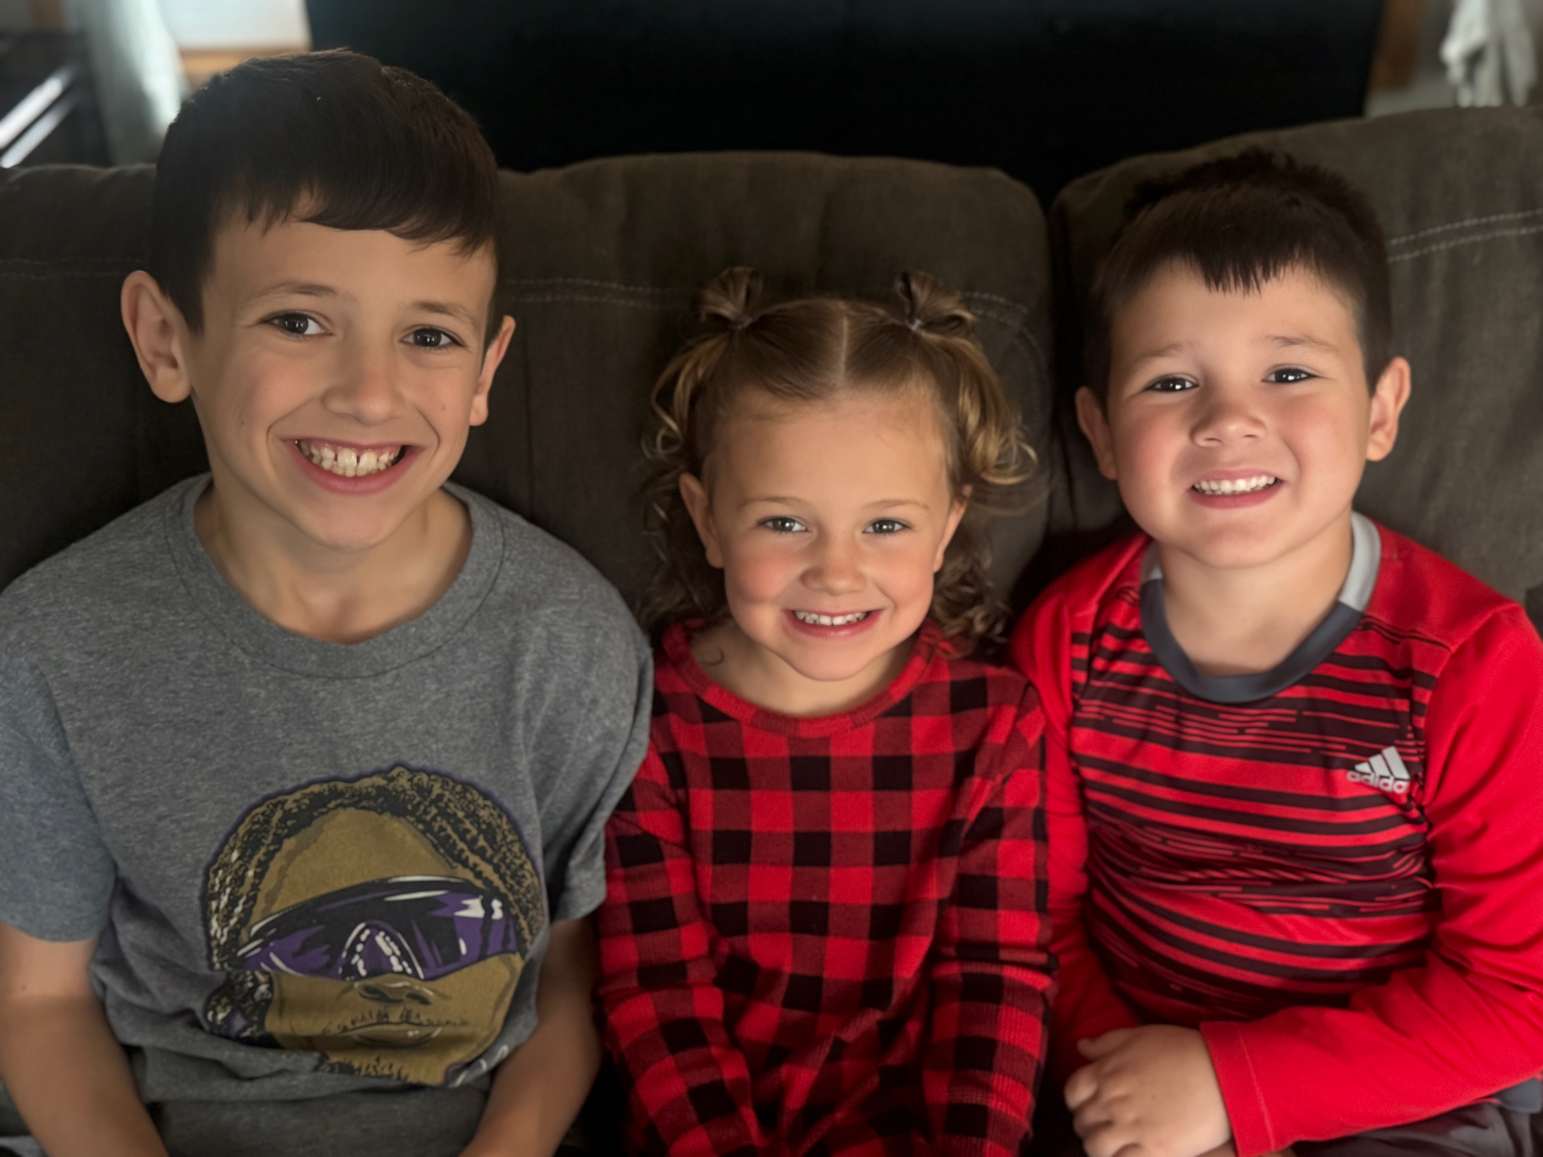
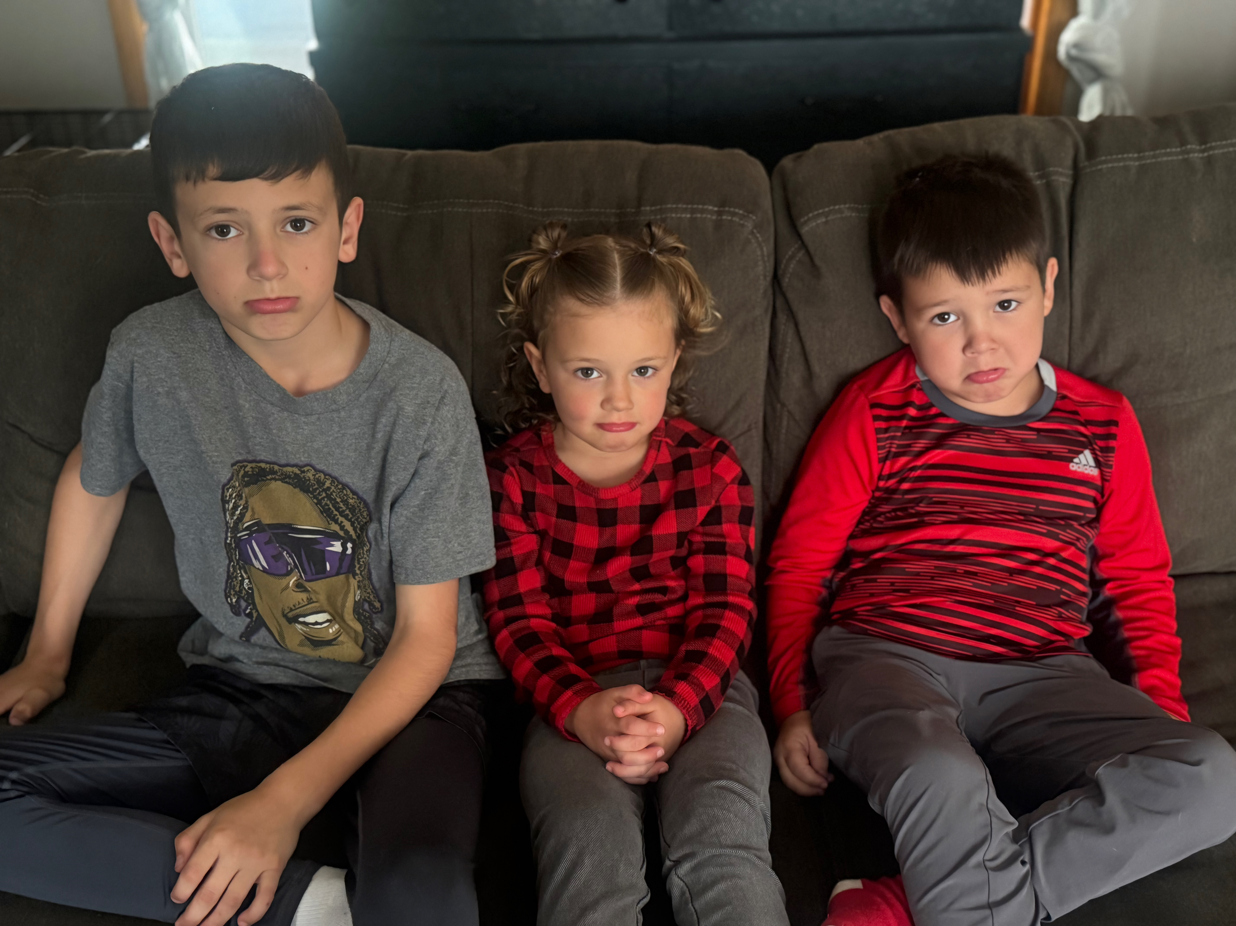
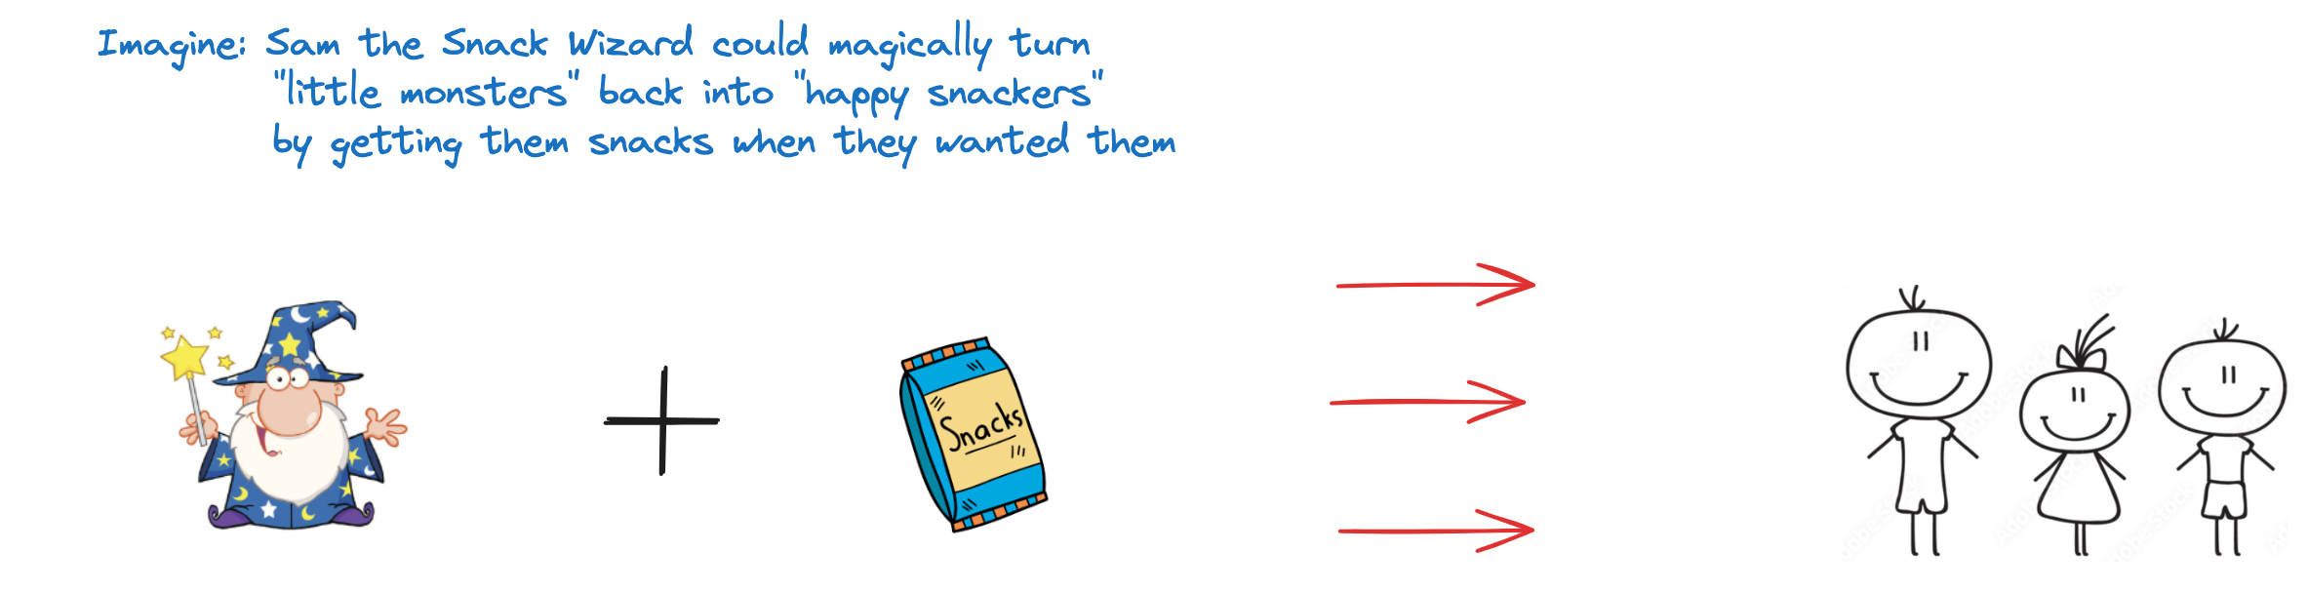
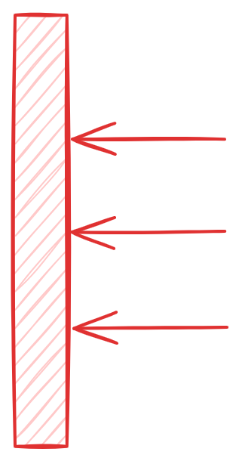
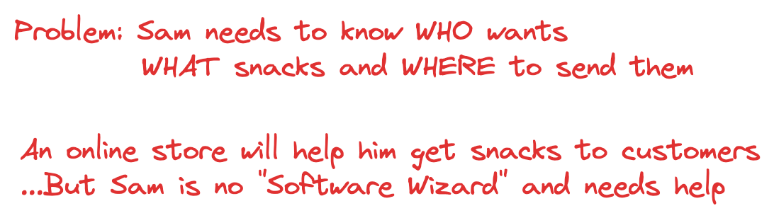
Set the Stage - ”The Persona”
X
Brady
Rylan
Oakley
Notes:
Every story you connect with starts with a persona. Relatable characters that you empathize with their needs, goals, and behaviors.
Our journey starts with the semi-fictional story, "Sam and His Snacks Unlimited Online Store".
Sam and His Snacks Unlimited Online Store
{Read the Story}
For the record, I am Pop and these are my REAL grandkids and they are awesome…WHEN they have snacks. I don’t have a picture of Mimi – her beauty would be too distracting for this talk.
...So Sam and Pop embarked on a journey to design and build Snacks Unlimited!!

Slide 8
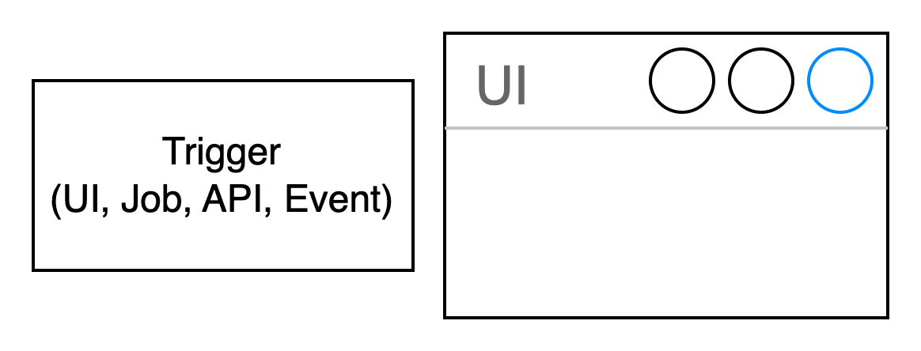
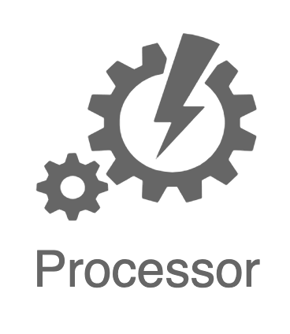
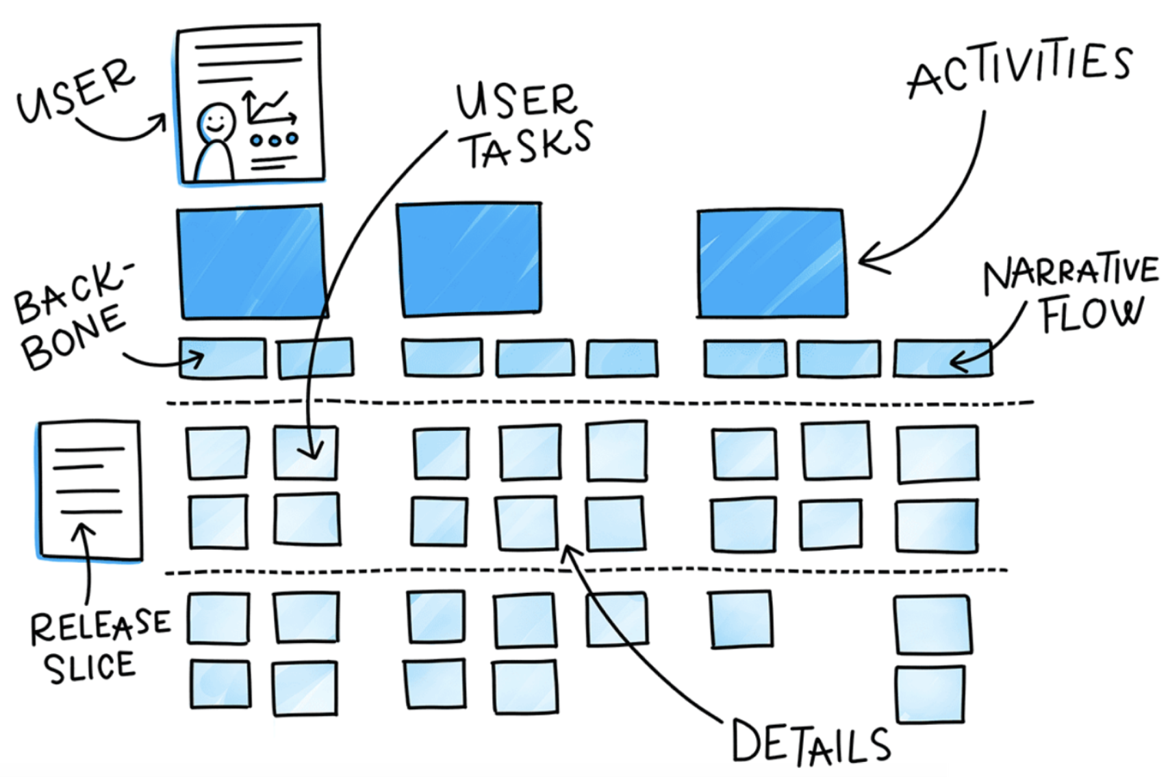
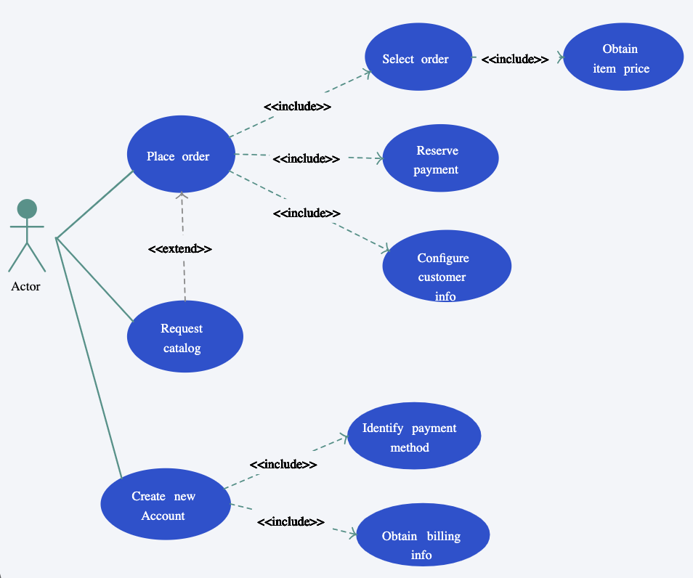
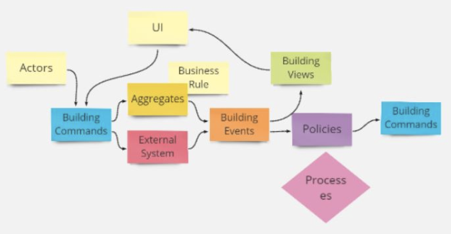
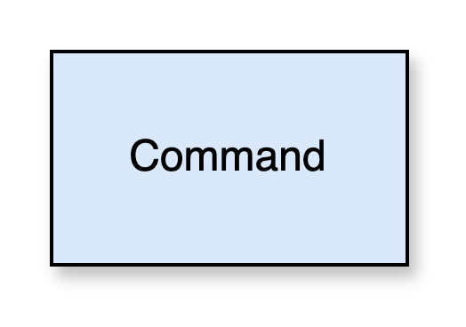
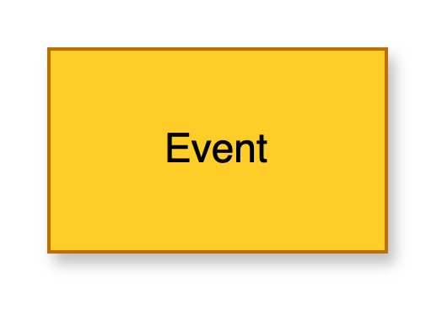
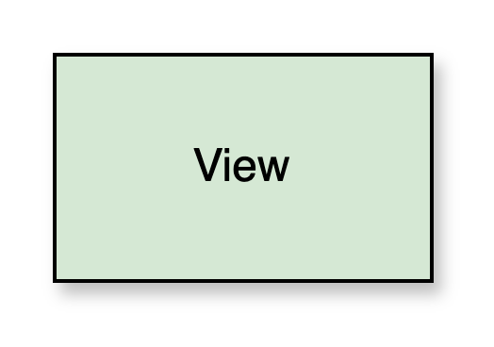
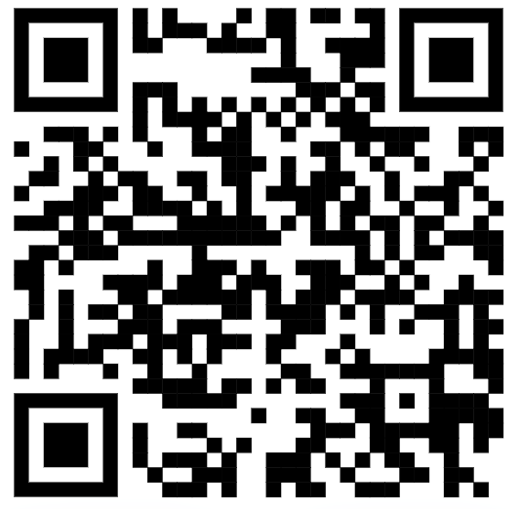
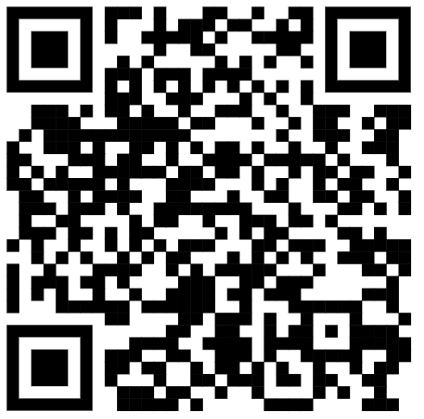
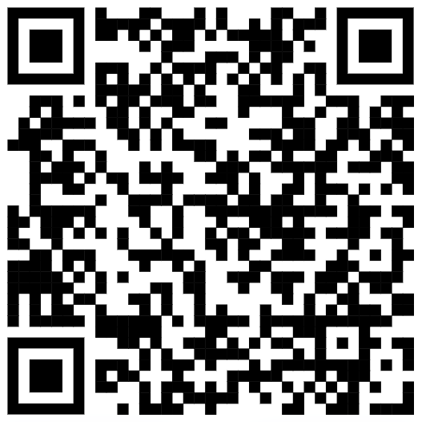
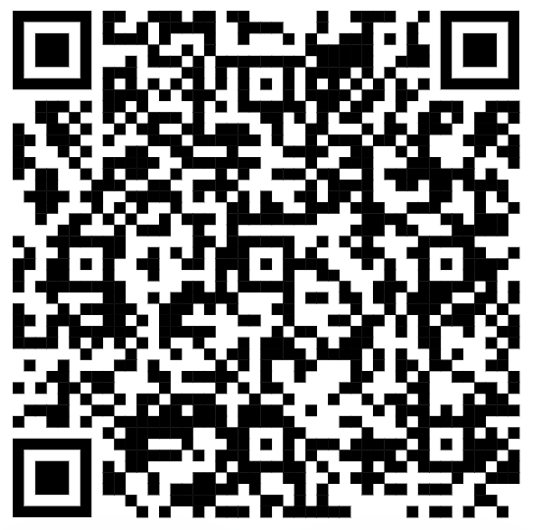
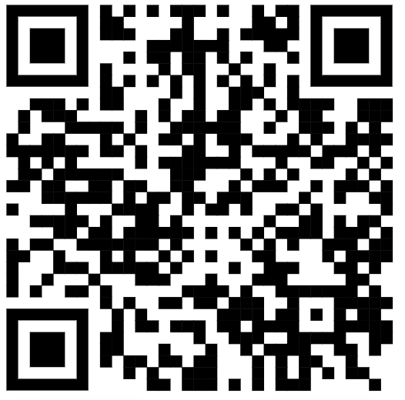
“Telling the Story” - Visualization
Pictographic Language
- Actors
- Work objects
- Activities
- Sequence
- Groups
- Annotations
Domain
Storytelling
Event Modeling
“Blueprinting”
User Story
Mapping
Use Case
Modeling
Event Storming
“next level”
event modeling
Notes:
Storytelling & Visualizing
Sam and I meet to witness Sam's magic, gather the requirements, and transform the domain knowledge into an effective online store. To get alignment and a solid understanding of what we are tasked to deliver, visually conveying functional requirements is an essential step.
Here are some of the methods I have used – and still use – to capture requirements in a visual way.
We decide to use two techniques, Domain Storytelling and Event Modeling (ie: blueprinting).

Slide 9
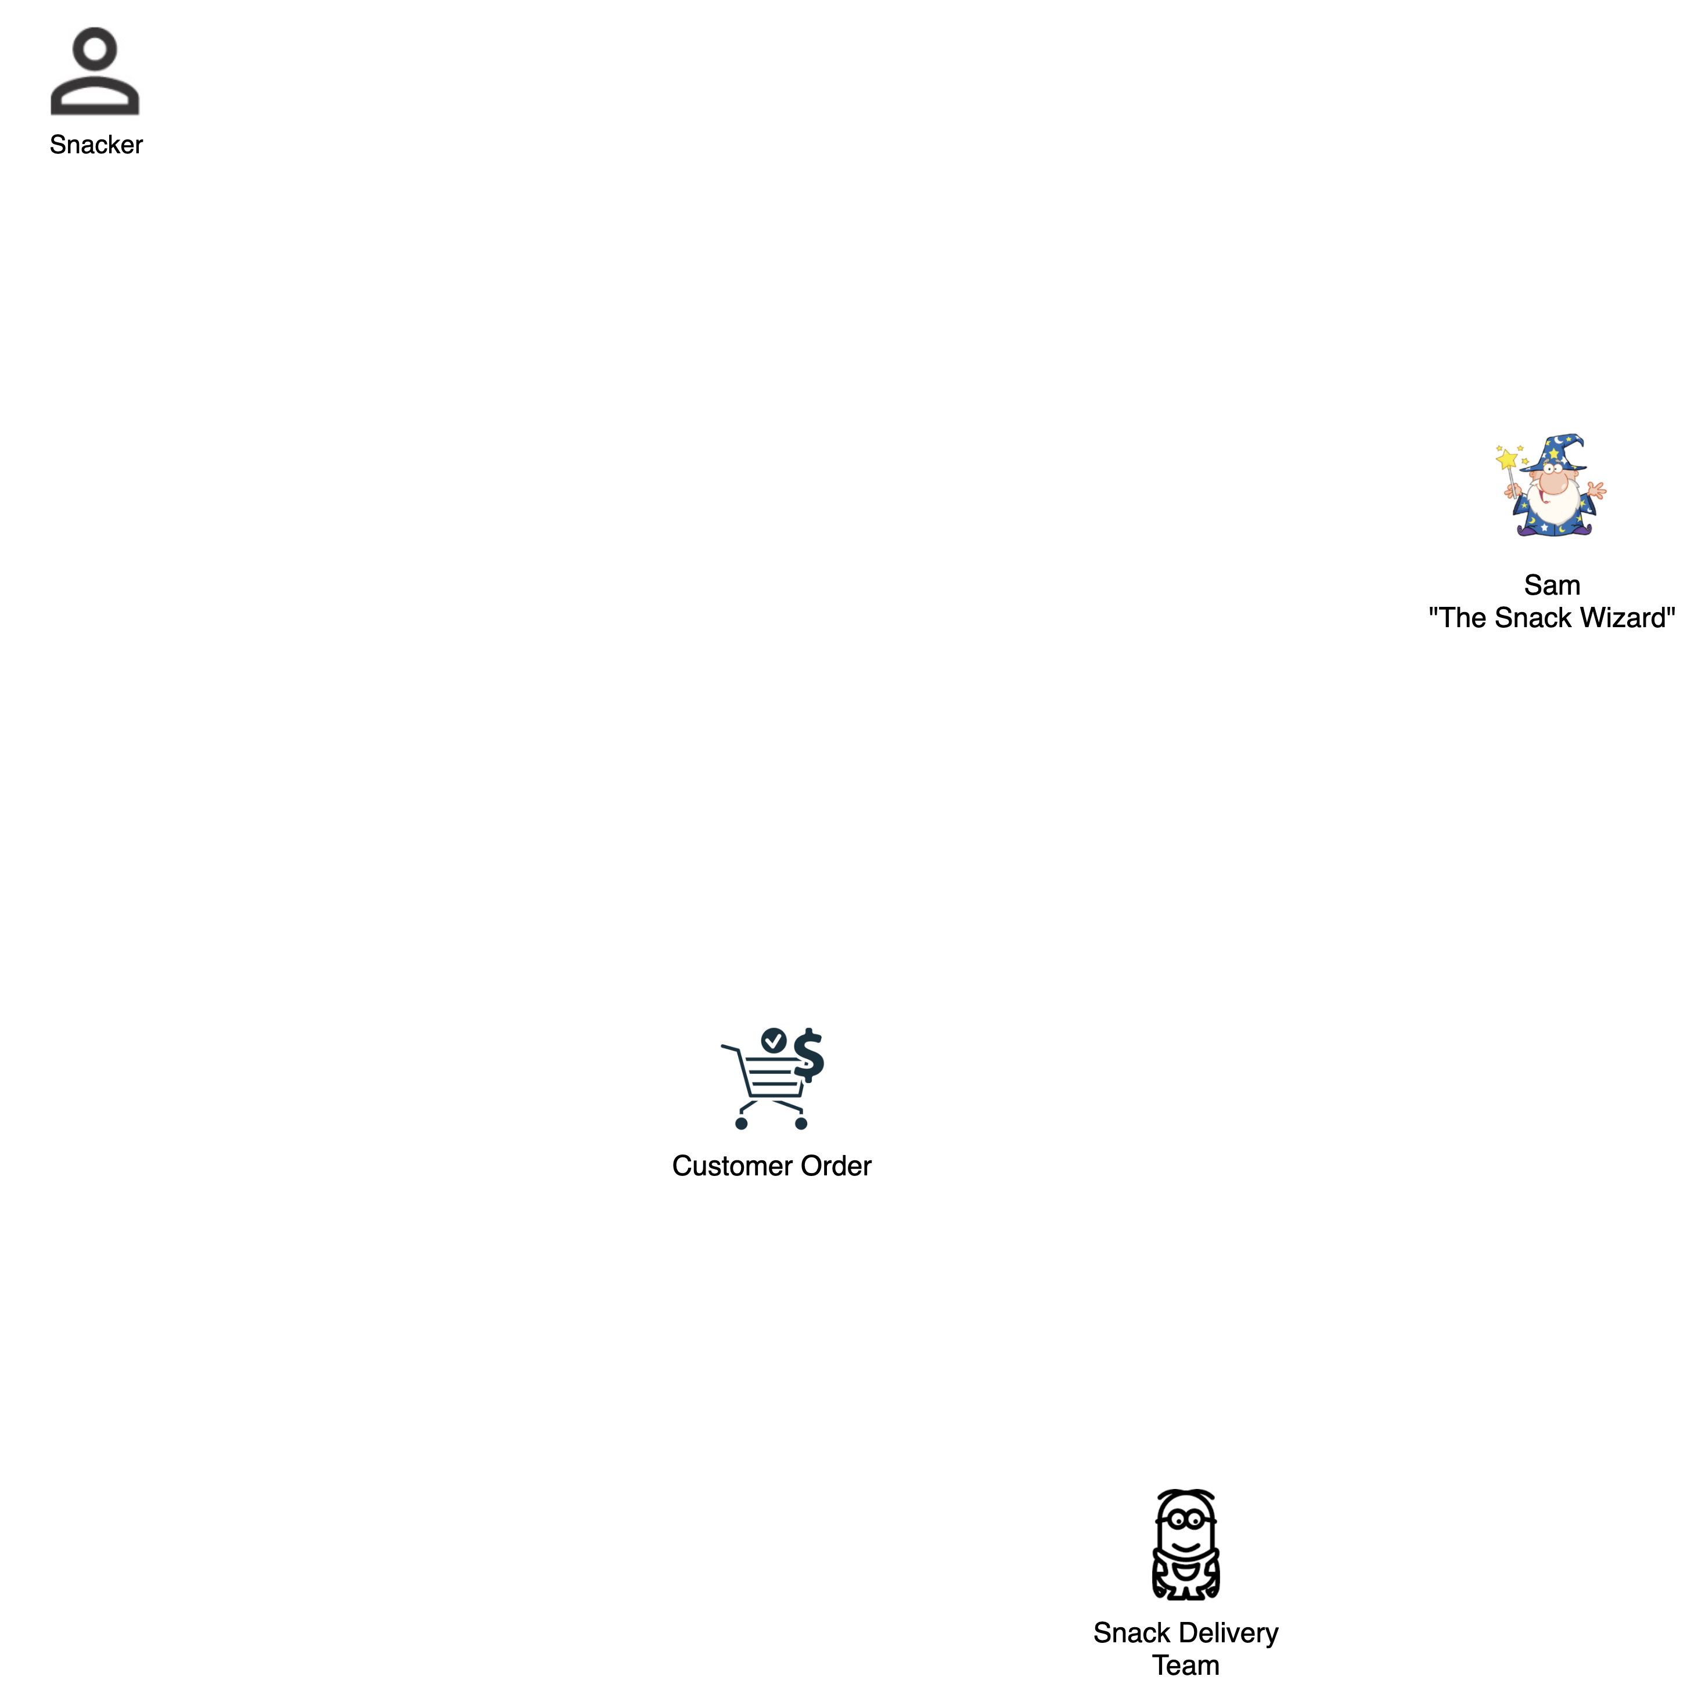

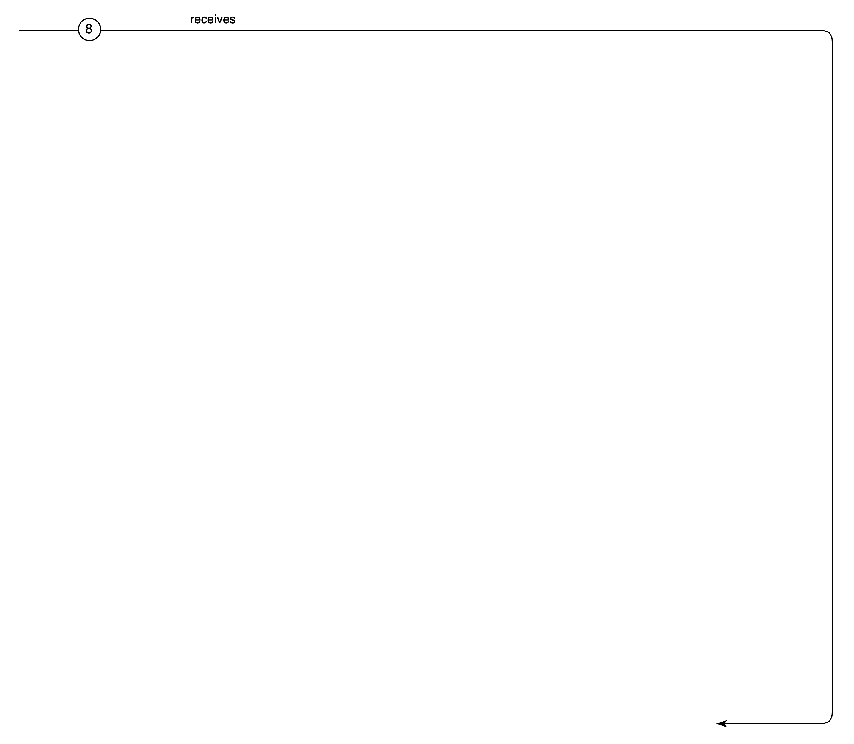
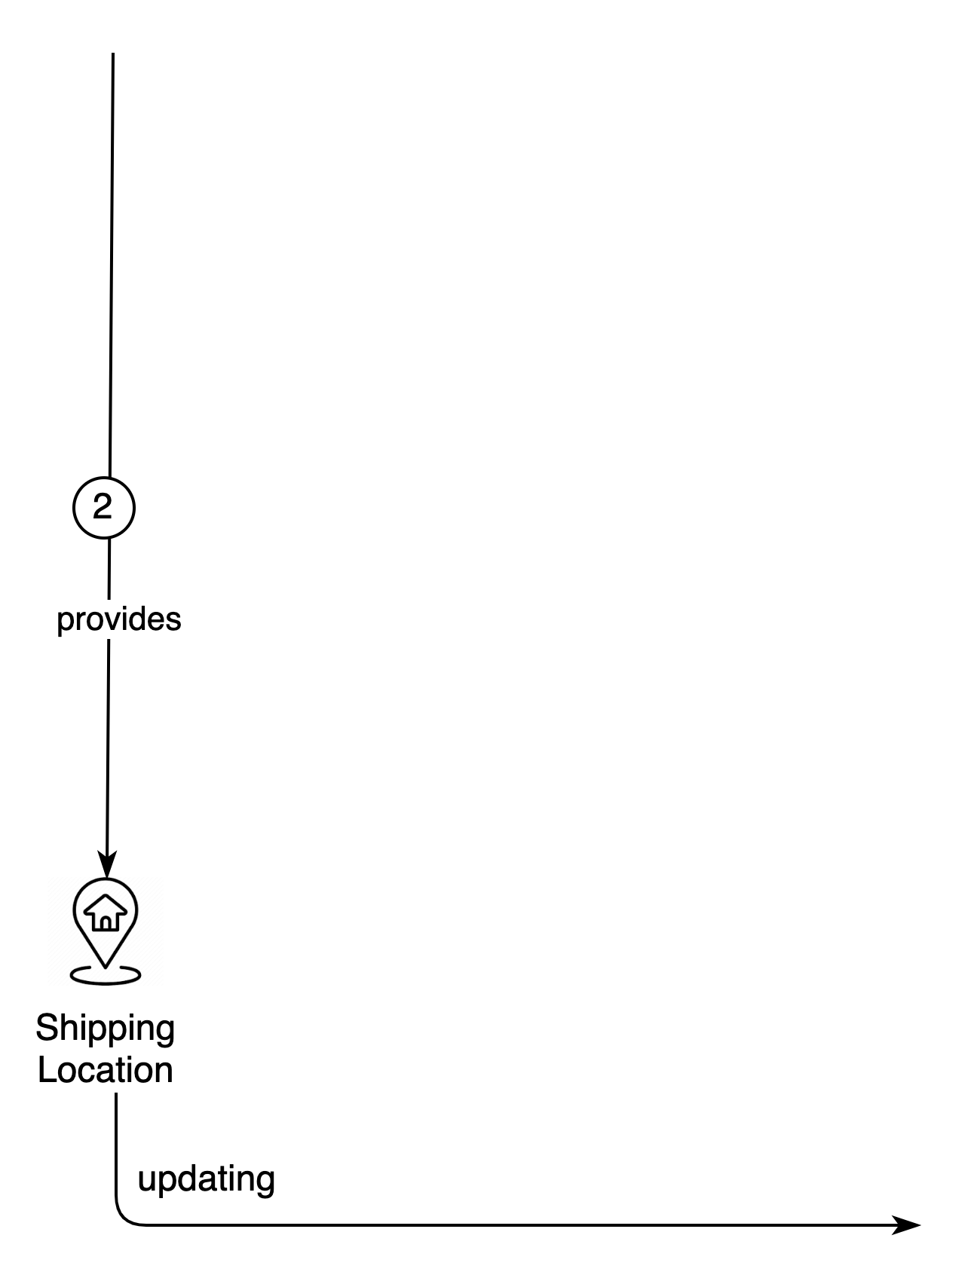
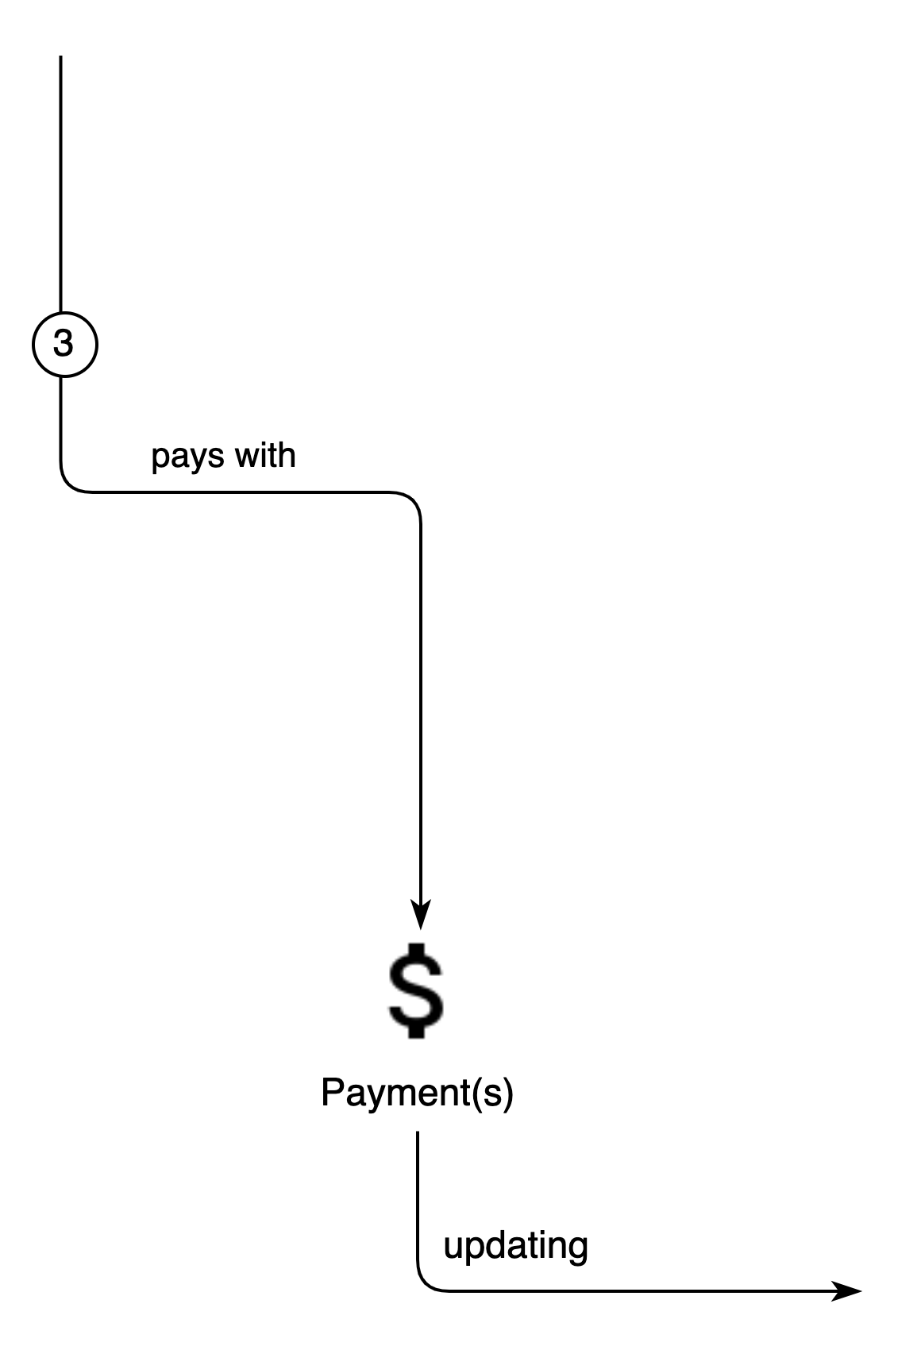
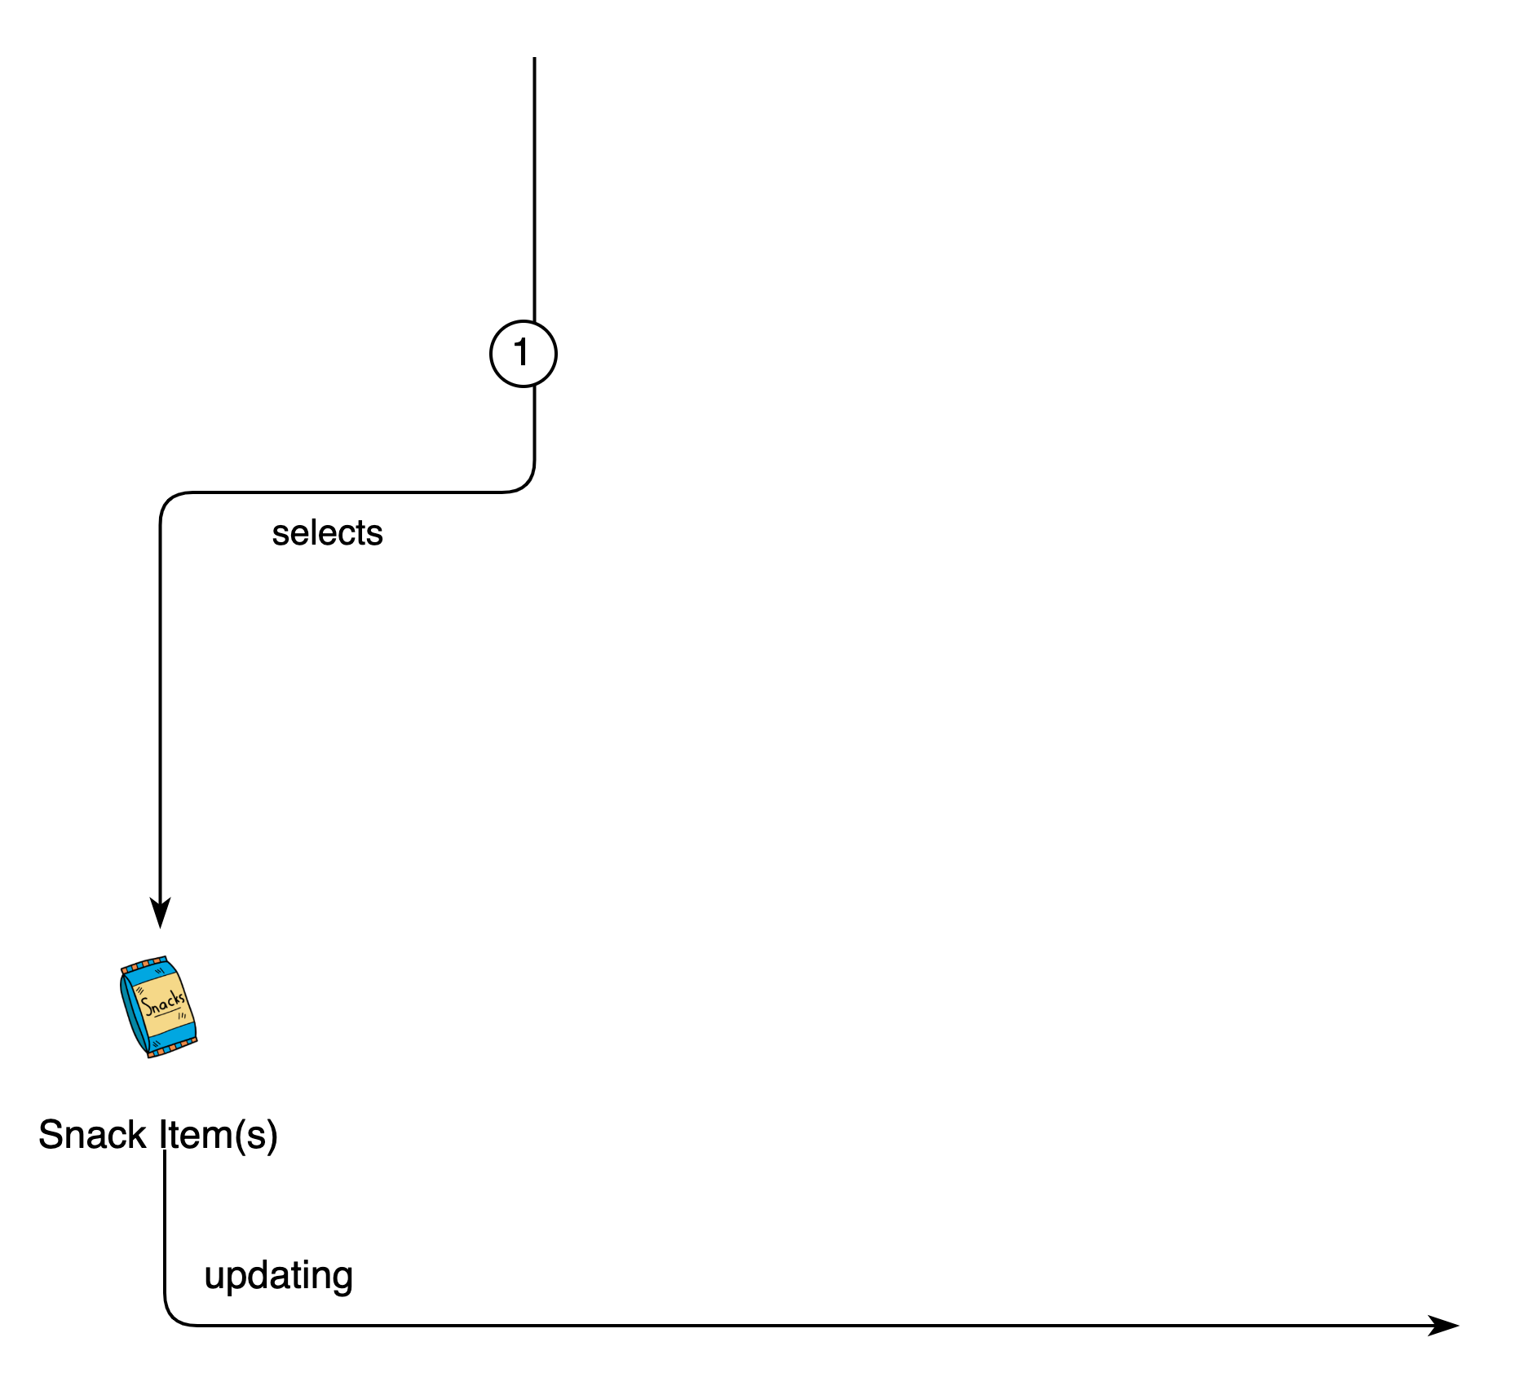
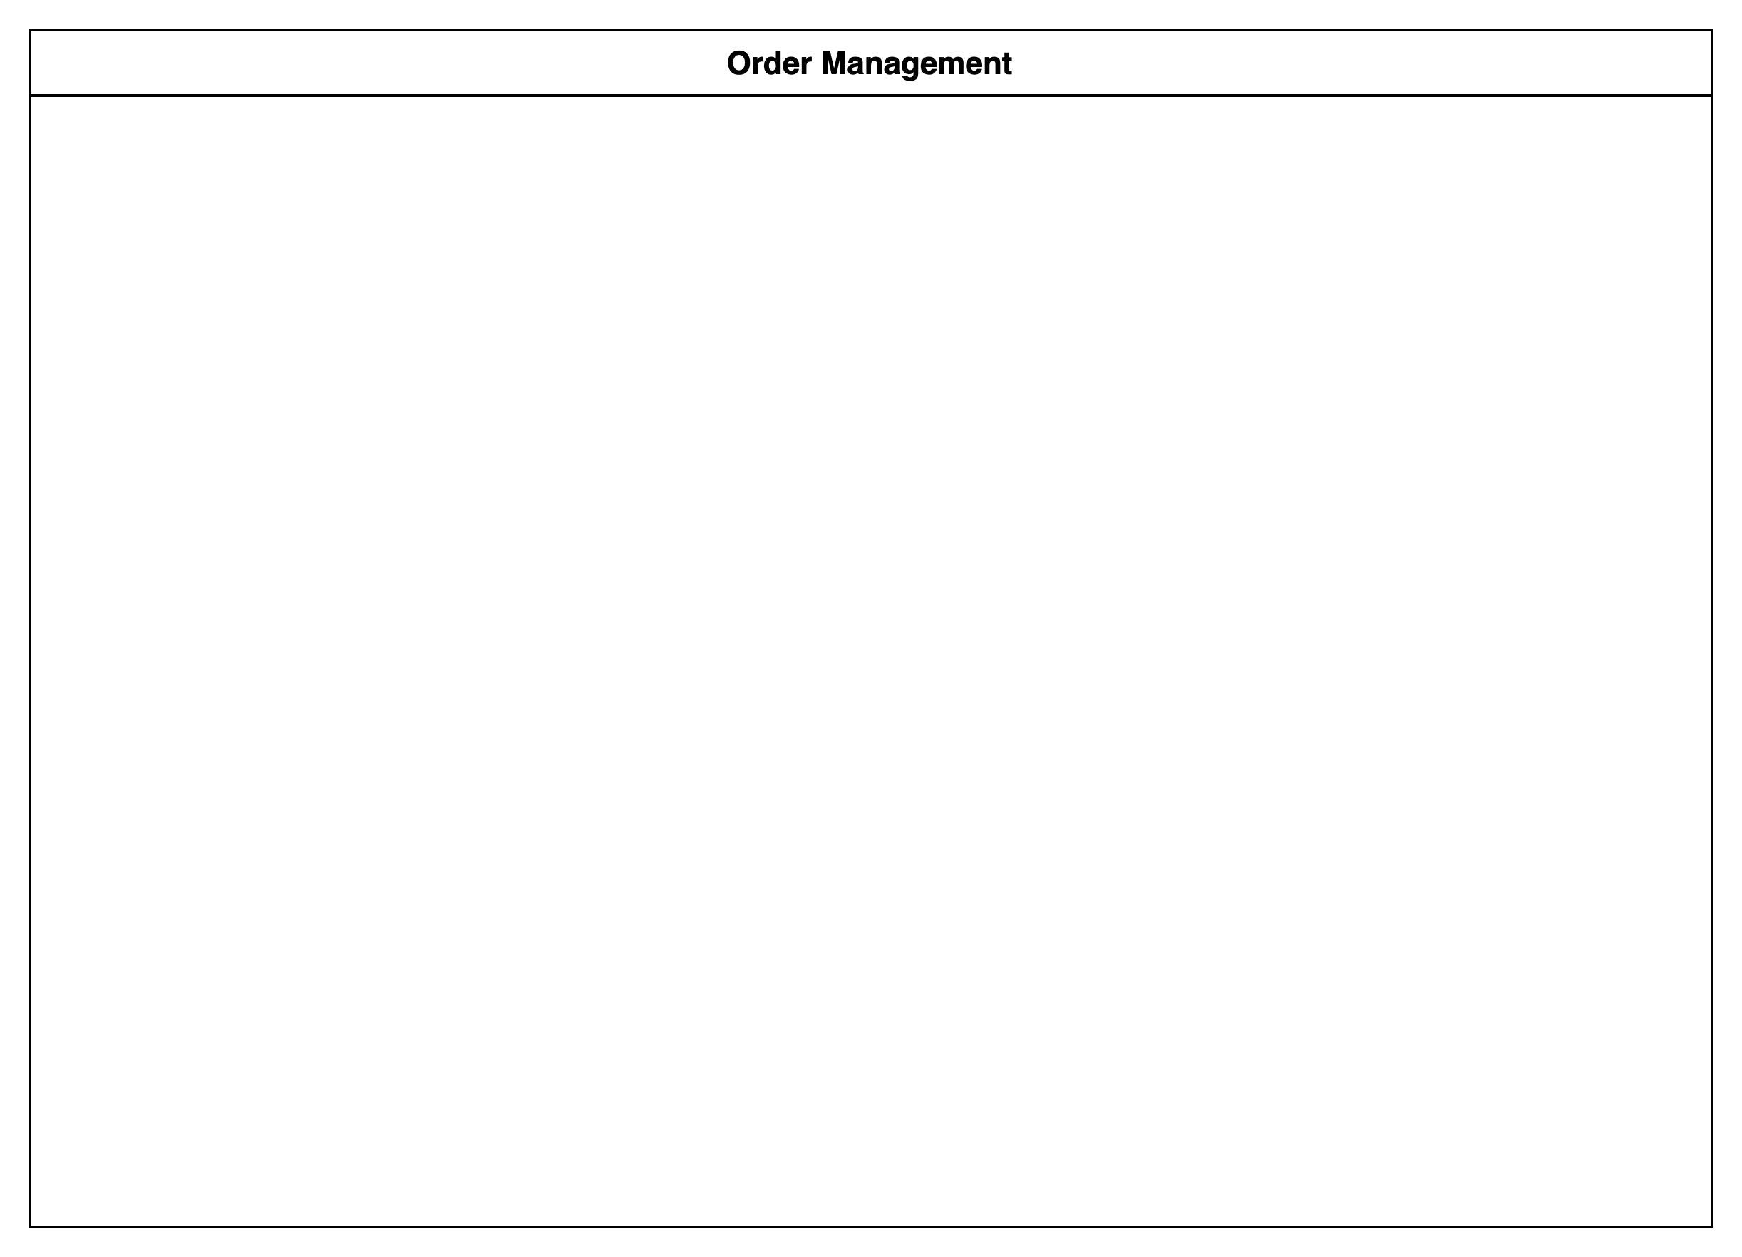
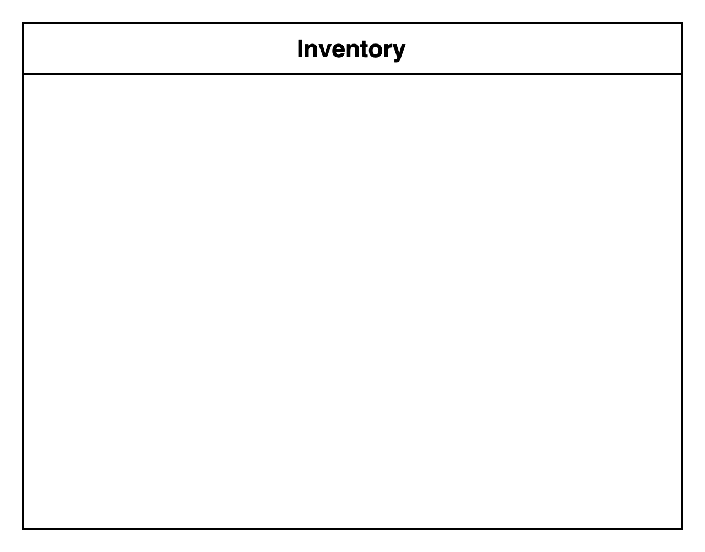
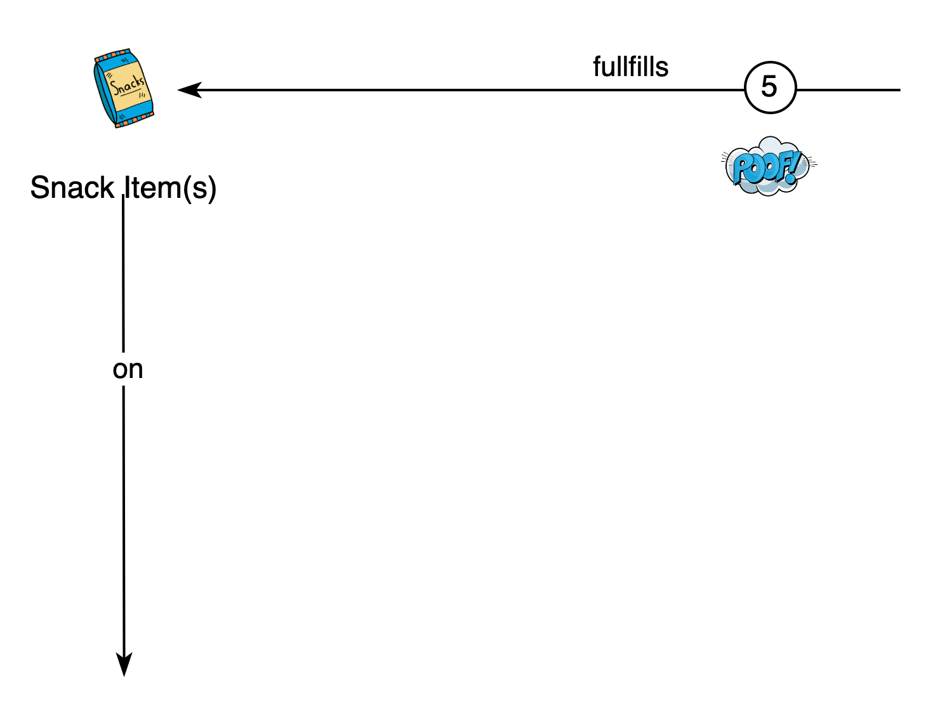
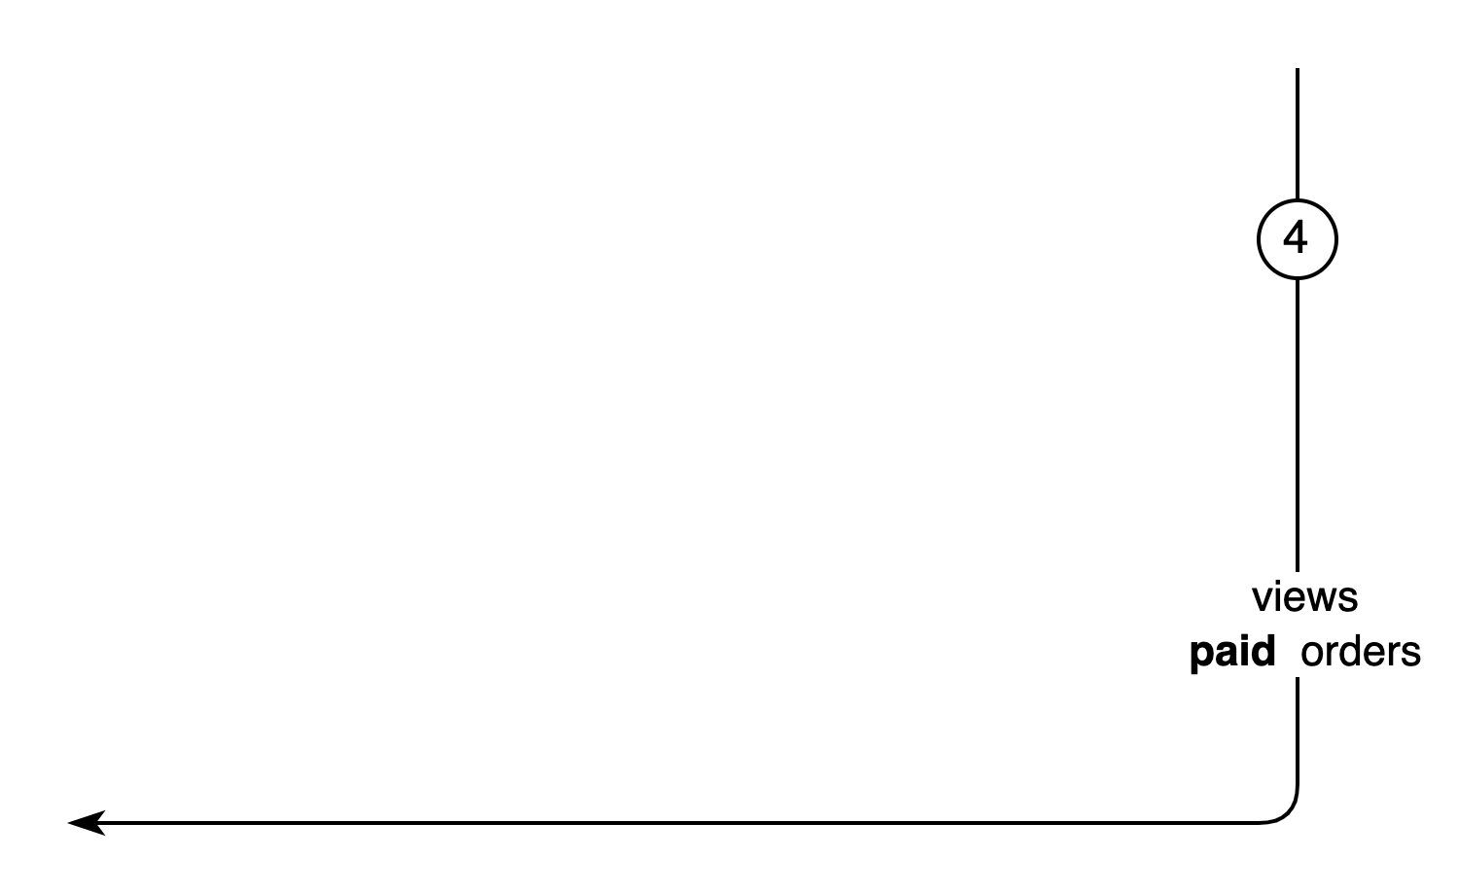
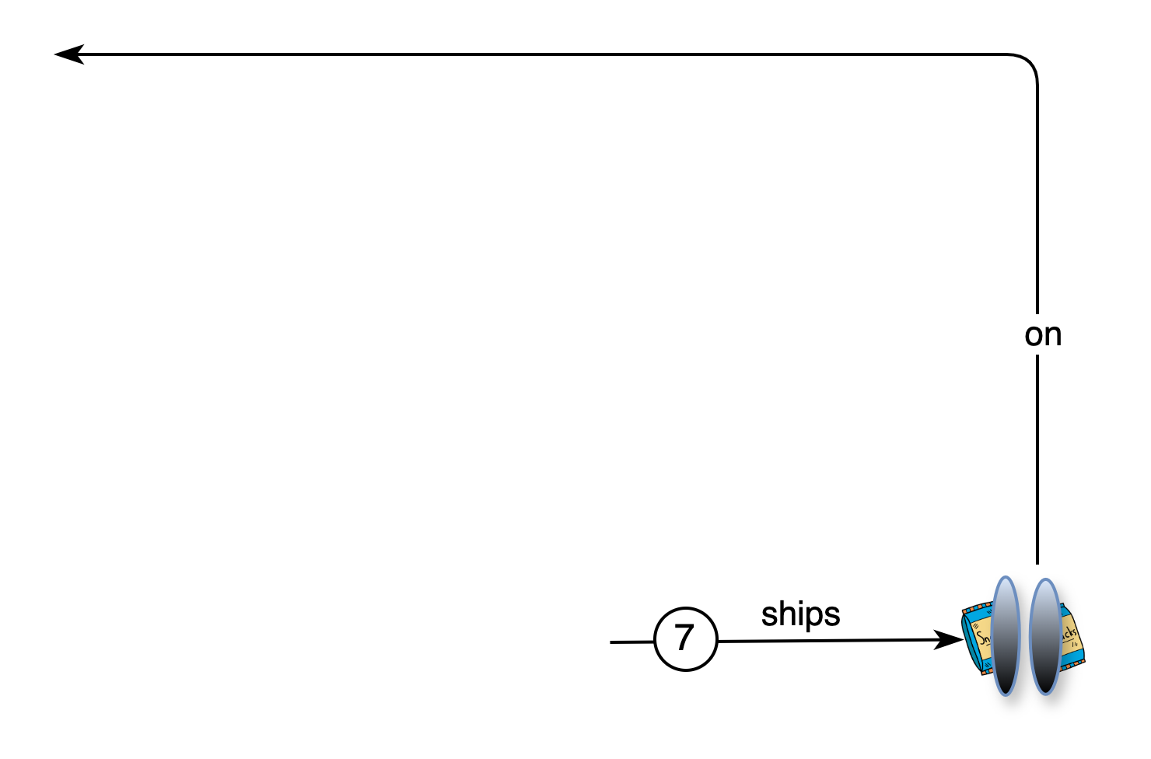
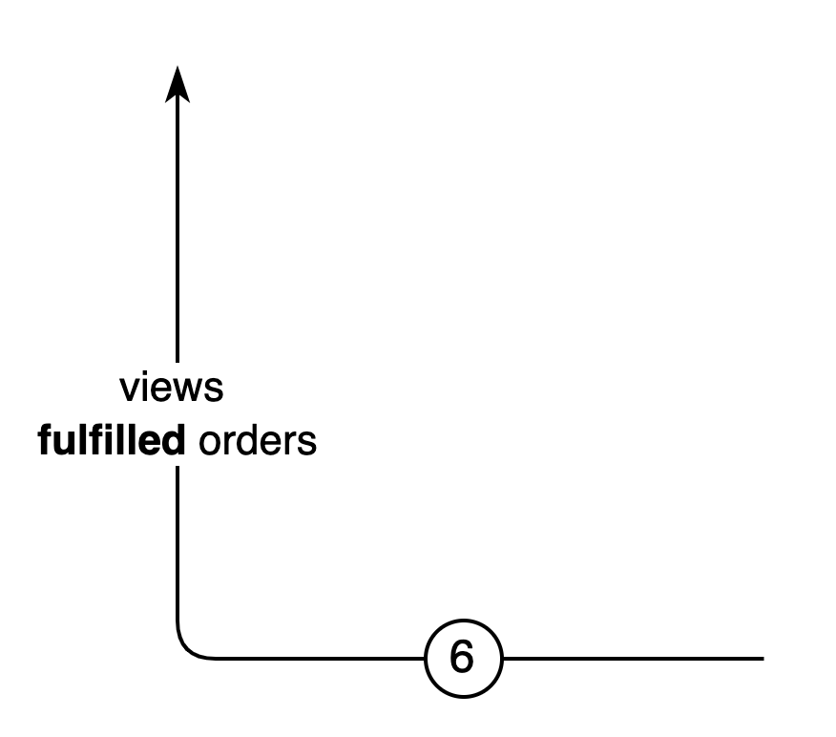
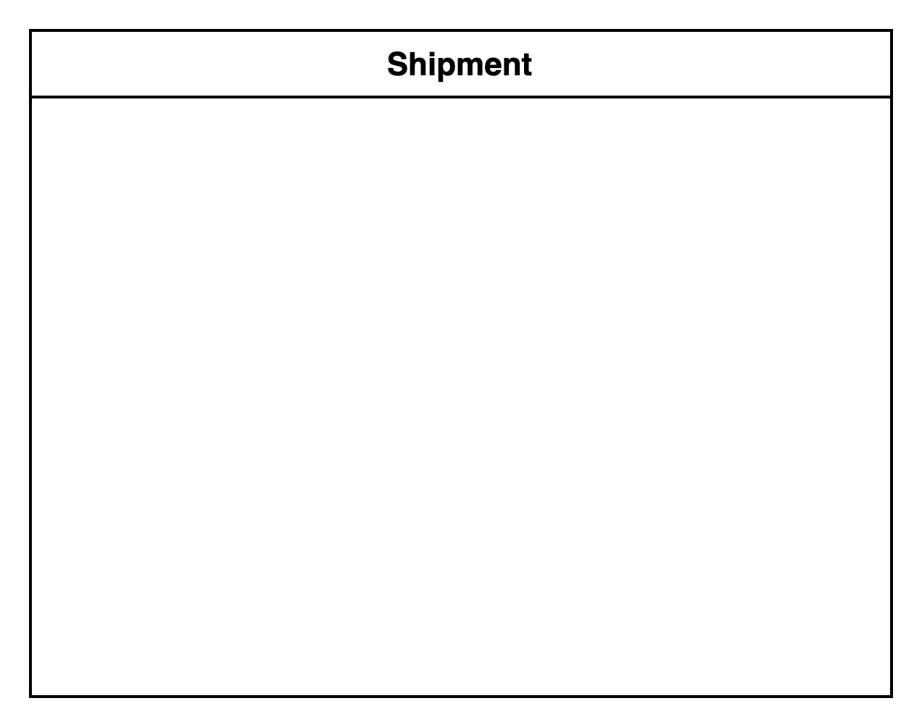
“Tell the Story” - Domain Storytelling
Pictographic Language
- Actors
- Work objects
- Activities
- Sequence
- Groups
- Annotations
“Your wishes are Sam’s commands”
“Sam needs a penny for your snacks”
Notes:
We anchor on the core requirements
"Your wishes are Sam's Commands"
"Sam needs a penny for your Snacks”
Domain Storytelling is a pictographic language involving actors, work objects, and the activities/interactions between them. This simple, yet powerful method aligns well with domain-driven design building blocks and is great at depicting TO-BE and AS-IS processes at various levels of granularity.
In the TO-BE process, we start with the actors and the key work object (Customer Order) – which will end up being our Domain Aggregate.
We go through the process flow, sentence by sentence gathering insights as we go.
Snackers Select Snack Items updating Customer Order
Snackers Provide Shipping Location, updating Customer Order
Snackers pay with Payment (visa) updating Customer Order
Sam Views Paid Customer Orders
POOF, Sam magically fulfills Snack Items on the Customer Order
A Team of Minions Views Fulfilled Customer Orders
A Team of Minions ships Snack Items through a Magical Portal
Snackers receive Snack Items through a Magical Portal
We also start to group parts of the story together to represent different aspects of the domain or system we see unfolding

Slide 10
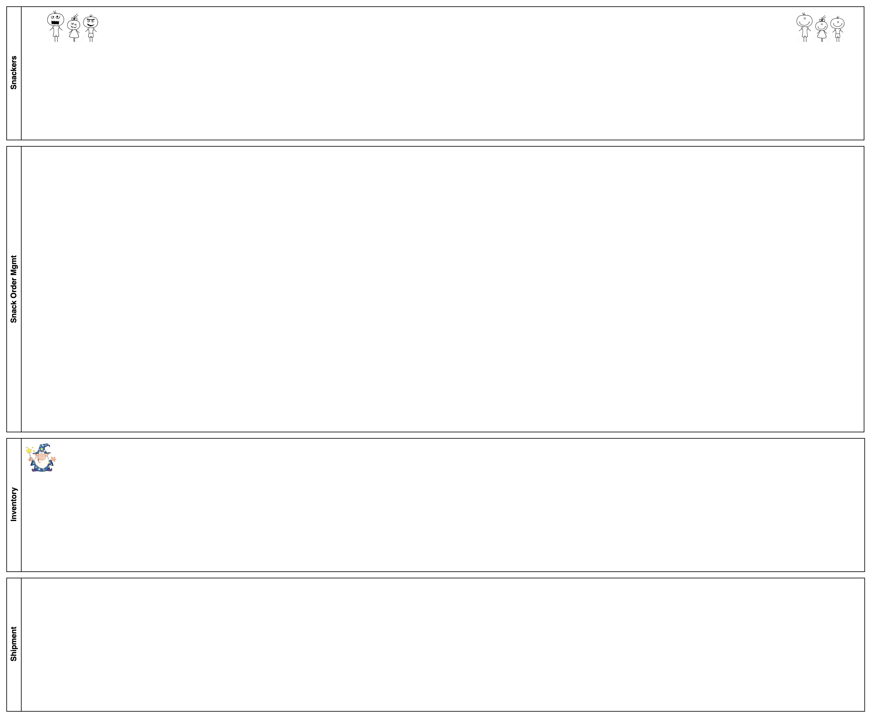
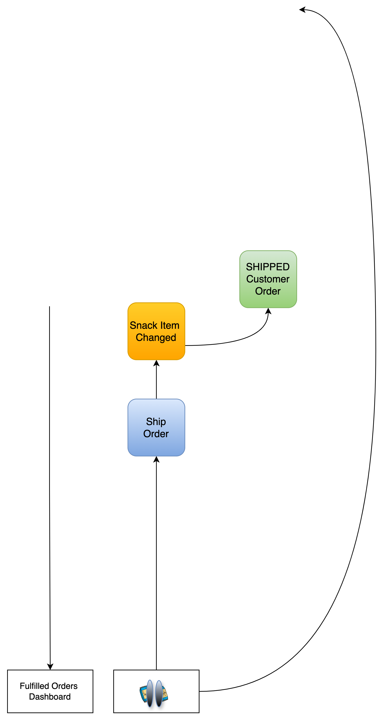
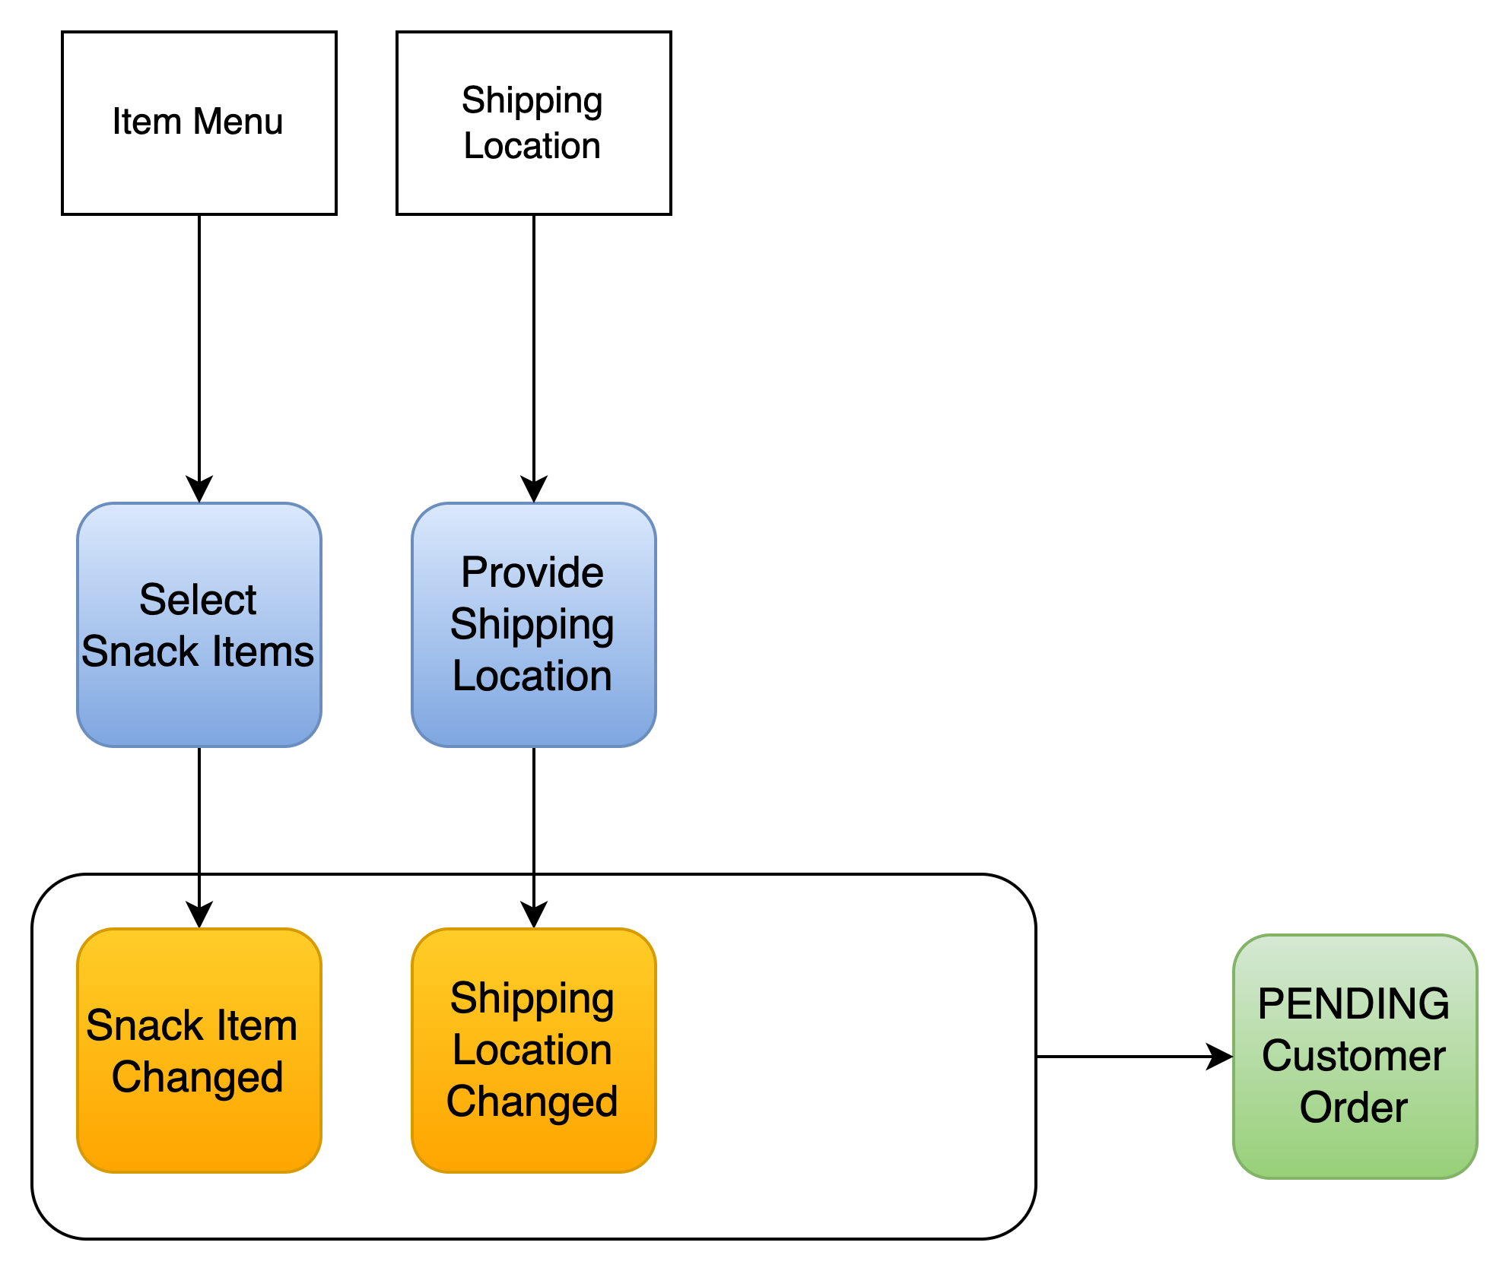
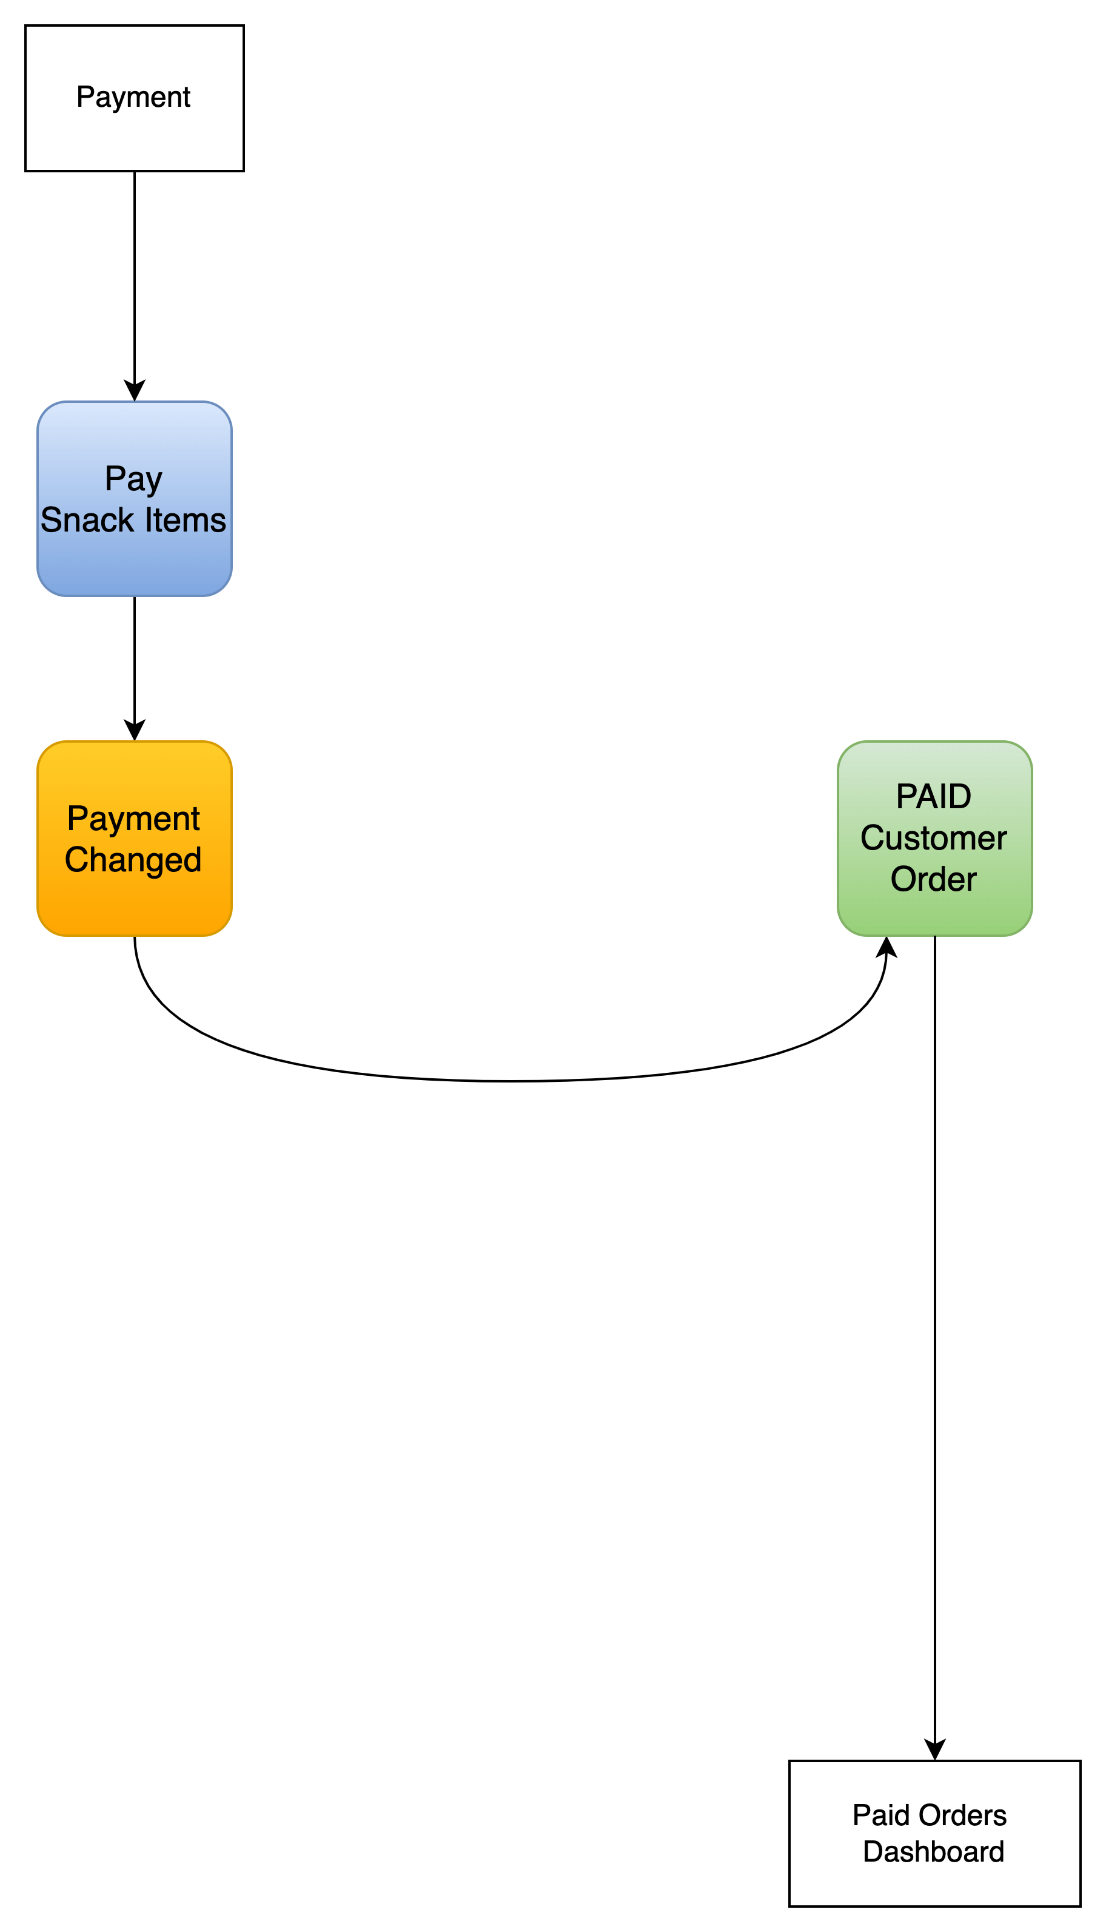
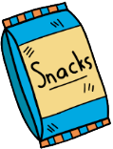
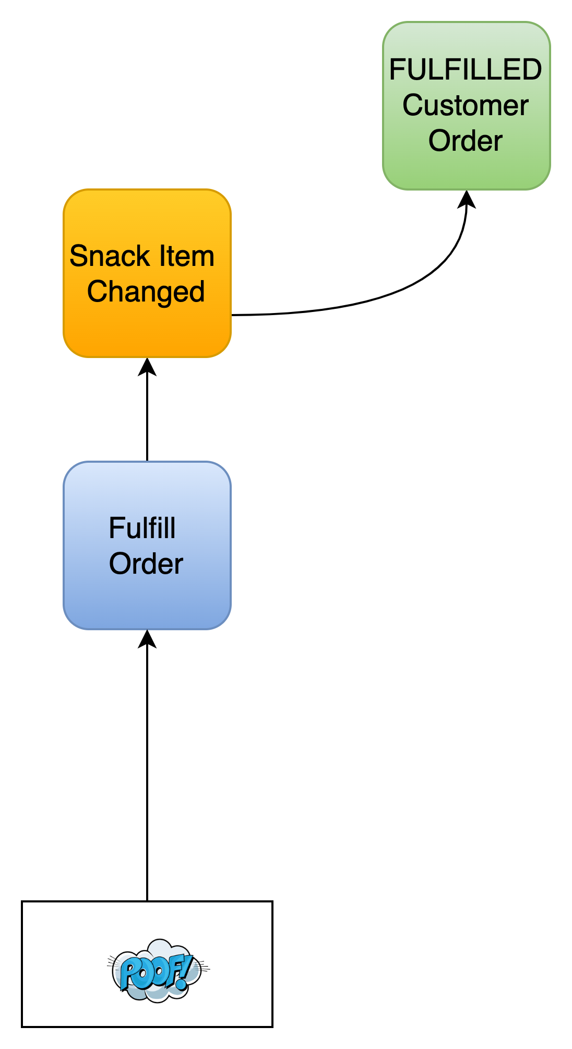
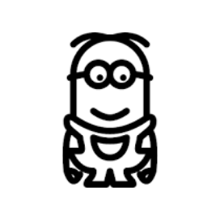
“Tell the Story” - Event Model Blueprinting
“Your wishes are Sam’s commands”
“Sam needs a penny for your snacks”
Notes:
Event Modeling is a way to blueprint a use case flow that visualizes the commands, events, and views on a timeline across system boundaries. This is an approachable method that is well-suited for capturing requirements for a distributed, event-driven system.
We start with the system boundaries. From left-to-right we hope to go from grumpy kids to happy kids with snacks. This blueprint, also brings to light another insight – the Lifecycle of a Customer (Snacker) Order.
Grumpy Kids
Select Snack Items command leads to Snack Item Changed events
Provide Shipping Location command leads to a Shipping Location Changed event,
Together this results in a PENDING customer order view
Pay Snack Items command leads to Payment Changed event, resulting in a PAID customer order view
Sam
Views Paid Customer Orders
POOF, Fulfill Order command leads to Snack Item Changed (fulfilled) events, resulting in a FULFILLED customer order view
Team of Minions
View Fulfilled Customer Orders
Ship Order command, leads to Snack Item Changed (shipped) events, resulting in a SHIPPED customer order view
We End with Happy Kids with Snacks – all is well

Slide 11

Notes:
Designing the System
After my working sessions with Sam, I have a solid understand of what is needed to build an online store integrated with Sam's magic. Keeping kids happy is a tricky business and I better not mess this up.
To make sure I don't, It is TIME TO Paint the PICTURE to Better Software through Solution Design Methods

Slide 12

Design the Solution
Methods “That Guide” Delivery
(DDD, System Design, C4 Modeling, 4+1 View)
Notes:
Early in my career, I might have looked at architects this way. Now that I am older and look like one, I see the value in solution design guiding delivery, instead of hacking away at code.
I continue to collaborate with Sam to define a system design that is well-architected and can scale to meet demanding snackers' wishes.

Slide 13








“Solution Methods”
Learning
Domain Driven Design
“The Method”
Righting Software
C4
Modeling
4+1
Architectural View
Notes:
Sam is eager to learn more about designing a software system that works with his magic. I highlight a few design methods I think will help capture the software system design to guide what will be developed.
We start with a CONTEXT OVERVIEW that captures our system design and its ability to meet the core use cases/requirements we uncovered during our storytelling sessions.

Slide 14










DDD Context Map
Notes:
First, we a draw a context map to build out the subdomains, bounded contexts, and integrations between them. This strategic DDD approach is essential to establishing context and clear boundaries.
From Sam's perspective, his "magic" and "snacks portal" are key differentiators and is "core to his business". The Payment System is a generic subdomain so we find a SaaS product we can integrate. The order management subdomain supports Sam.
"Integration Between Contexts"
Partnership – We have a reliable partnership with the core domains since we trust "Any Snack is Always Available" & "Snacks can be Delivered Anywhere".
Conformist – We conform to the model and interface of the Payment SaaS.
From my perspective, the Order Mgmt supporting subdomain is critical. It must scale to accept snackers' wishes independently from viewing lifecycle changes of customer orders. A simple CRUD app won't do.
Customer/Supplier: We draw two bounded contexts within the subdomain. The Snack Order Commands bounded context supplies data that the Snack Customer Orders bounded context consumes and transforms into Queryable Customer Orders - through an Anticorruption Layer (ACL).

Slide 15









Righting Software “The Method” - System Design
Notes:
The Context Map helped defining the system bounded contexts. Next, we explore using a system design method from the book "Righting Software" simply called "The Method". In this exercise I decompose the system to isolate the impact of change (decomposition by volatility).
I like the resulting "System Design Canvas" view and what it conveys at a high level (who will use it, what the system does, how it does it, and where resource data is stored in the system). By isolating volatility, we can build a cohesive, loosely-coupled system that can withstand change while evolving the architecture. “The Method” lays out “process manager services, component/engine services, resource access services, resources, and utilities as system building blocks that best encapsulate volatility. These services can align to DDD building blocks.
A few callouts:
I know order processing can evolve - so I define an Order Processing Engine component.
I also know that magic can be volatile and needs to be handled with care - so I want keep these aspects separate.
The Utilities complete the overview by providing the foundational plumbing for system services to integrate and function.
We further break down the system into smaller, more manageable subsystems that are a part of a larger system. This ensures we properly encapsulate the Order Mgmt system functionality we are delivering.
Sam is satisfied with the high-level design, trusts me, and leaves me to develop and deliver the full solution.

Slide 16

4 + 1 Architectural View Model
Sprinkle in UML to complete the picture
Logical (state, class)
Process (sequence, activity, flow)
Development (package, modularity)
Physical (deployment, infrastructure)
Logical – State Diagram
Customer Order
Notes:
Before diving straight into code, I REFINE and DOCUMENT the design to help guide the delivery of the system.
I document key tactical design decisions.
I also document the design sprinkling in some 4+1 UML Architecture Views - yes UML still has value :-)
For this design, a UML State Diagram showing the lifecycle of a
Customer Order is useful.

Slide 17







C4 Model (Context)
Notes:
I also use the C4 modeling framework, to provide a system context view, container view, and various component-level views I find useful. Each view provides more detail as we zoom in from context to code.
We start with a Context View of the Snacks Unlimited system.

Slide 18

C4 Model (Container)
Notes:
We zoom into the Container View. Here we start to see things take shape as we get closer to IMPLEMENTATION/CODE. The containers show the individual runnable/deployable units (applications, jobs, datastores, topics, connectors) that bring everything together.
Snackers, Sam, and his Minions send commands to the “snack-order-commands” services.
These Order Commands are stored in a MySQL Database
A Debezium CDC MySQL Source Connector is configured to capture DB changes and sink changes to snackItem, shippingLocation, and paymentTx Kafka topics.
A “Snack Order Processor” consumes messages off these Kafka topics – I compare "like solutions" using Kafka Streams vs FlinkSQL for the Snack Order Processor. Since we spent the time thinking through a well-designed system, the order processor change is isolated and implementations can be swapped without impacting the other system components.
The processor joins snack items, shipping location, and payments into a customer order and publishes these Aggregates to the customer-order-aggregate Kafka Topic
A MongoDB Sink Connector consumes customer order aggregate messages and sinks them to a Customer Orders MongoDB store
Sam and his Minions can view orders through the "snack-customer-orders" services.

Slide 19

Streams Topology (Component)
Notes:
We can zoom in further to the snack-order-processor Kafka Streams app container to understand the stream topology to build the Customer Order Aggregate
map to KTables from source topics
Use groupBy to group snack items into a list)
Join the snack item list + shippingLocation to create a PENDING order
Left join with payment to transition to a PAID Order
Sink the Customer Order Aggregate to customer-order-aggregate topic
Maybe in future iterations I will explore different Kafka Streams Topologies. Perhaps I can use nuggets I picked up from Neil Buesing’s ”Choose your Own Kafka Streams Adventure” talk earlier today.

Slide 20

FlinkSQL Job Overview (Component)
CDC to Kafka
DDD Aggregate to Kafka
<kafka topic>
Item_details
<kafka topic>
customer-order-aggregate
<kafka topic>
Shipping_location
<kafka topic>
payment
Notes:
We also zoom into the Flink Job Overview to see a component view of the stream processing that aggregates and joins Snack Commands into a Customer Order Aggregate that is sinked to the customer-order-aggregate topic

Slide 21

Notes:
After a well thought out design phase, using design methods to “paint a clearer picture”, I can iteratively code the Snacks Unlimited services and components aligning to the design.
At last, I am ready to demo the RESULTS to Sam. This “story to design to code journey” is nearing a successful conclusion.

Slide 22

Demo the Result
“The Playground”

Slide 23



Playground – Kafka vs Redpanda vs WarpStream
Notes:
As part of development, I make sure I can run “the containers” in an integrated local Dockerized Playground for testing and experimentation. One experiment is to compare different Kafka-compatible stream processing platforms, giving Sam some options as we evolve and grow Snacks Unlimited.
Whether it is "Confluent Kafka" or "Redpanda" or recently "WarpStream by Confluent", I verify I can swap out different stream processing engines without impacting the Snacks Unlimited Applications.
Redpanda - written in C++, no Java dependency, offering lower latency and better performance on modern hardware.
WarpStream - decouples storage and compute allowing you to "bring your own cloud". It uses object storage like S3 to reduce infrastructure costs and simplifies scaling. WarpStream Agents are "stateless" and no need for "local disks".

Slide 24

DEMO: API-Driven
Notes:
I go through an API-driven demo with Sam, using Brady, Oakley, and Rylan (remember them) to show off the Order Processing Capabilities and functioning system.
Sam likes what he sees and cannot wait to “Go Live” and spread his magic around the world.
To speed things up, I vibe code the frontend web components with the help of WindSurf and Claude AI to get to a finished Snacks Unlimited Product.

Slide 25

Promotion – Limited Time Offer
Scan & WIN!!
HURRY!!
Notes:
I could carry on and demo the fully functioning playground locally, but Sam is so excited and ready to test out the system. “SO TODAY YOU HAVE BEEN SELECTED TO PARTICPATE" in a promotion to help test out the system and his magic.
Go ahead, Scan and Get your Wish Commands IN!! The first four customers will get a Snickers - if the system and Sam's magic WORK 😃
Snack Promotion WINNERS - Let's see who the four lucky winners are.

Slide 26


Notes:
Finally, at LAST we reach the end of our journey!!
Everyone lives happily every after ☺
- Brady, Oakley, and Rylan always get their snacks and are never sad.
- Mimi & Pop remain the best grandparents, and Sam is ready to spread snacks and joy around the world!!

Slide 27


Check it out on GitHub
(https://github.com/improving-minnesota/demo-ordermgmt-cqrs-cdc)
Notes:
Check it out on GitHub This GitHub project is packed with many goodies for you to play around with on your own learning journey.
"Context to Code" exercises like this, that go beyond "do and forget" tutorials, continue to help me apply the things I learn.
THANK YOU
FAQs
🧱 Domain-Driven Design & Modeling
1. How did you handle boundaries between aggregates? We used DDD context maps to define clear bounded contexts. Aggregates were designed to avoid cross-context writes. Integration was event-based using Kafka to preserve autonomy.
2. What were the challenges of using DDD with asynchronous systems like Kafka? Main challenges were ensuring consistency and ordering. We embraced eventual consistency and relied on idempotent processing, deduplication logic, and schema contracts via Protobuf/Avro.
3. How deep did you go with tactical DDD patterns? We leveraged a domain-model implementation using key DDD building blocks:
Aggregates, Entities and Value Objects
Services and Factories
Repositories We selectively used Factories for aggregate creation, Repositories to abstract persistence, and Domain Services for business logic. Not all patterns were necessary due to microservice isolation.
📤 CQRS & CDC Patterns
4. Why CQRS + CDC over CRUD? CQRS + CDC provided separation of concerns and enabled scaling write-heavy operations independently. CDC let us derive read models without impacting write-side performance.
5. How do you prevent CDC bottlenecks or data integrity issues? We used Debezium with Kafka Connect, ensuring schema evolution support via a schema registry. Monitoring and alerting were essential for catching lag or transformation issues.
6. How is eventual consistency and failure handled? We implemented compensation logic in consumers. Kafka’s at-least-once delivery ensures no events are missed, and retries handle transient failures.
☁️ Architecture & Infrastructure
7. Why use both MySQL and MongoDB? MySQL was used for transactional consistency on the command side. MongoDB supported flexible, denormalized read models optimized for API consumption.
8. Kafka Streams vs. FlinkSQL – how do they fit? Both process event streams. Kafka Streams offers low-latency, embedded stream processing. FlinkSQL is better for complex transformations and SQL-based ETL in real time.
9a. What is the difference between Kafka and RedPanda in two sentences? Kafka and Redpanda are both event streaming platforms, but Redpanda is a Kafka API-compatible alternative written in C++ with no Java dependency, offering lower latency and better performance on modern hardware. Unlike Kafka, Redpanda claims to have a simpler architecture and is optimized for single-binary deployment and ease of use (SMALLER FOOTPRINT).
9b. What is the difference between Kafka and Warpstream in two sentences? Kafka is a distributed event streaming platform that stores and processes high-throughput real-time data streams using a self-managed or cloud-hosted cluster. WarpStream is a Kafka-compatible streaming platform that decouples storage and compute, using object storage like S3 to reduce infrastructure cost and simplify scaling.
Unlike Kafka, WarpStream doesn't require brokers or ZooKeeper for cluster management. The single Agent handles all coordination. WarpStream Agents are stateless, meaning they don't maintain any state on their local storage. This allows for easy scaling and deployment. WarpStream offloads all storage to object storage, which means there's no need for local disks on the Agents. This further simplifies operations and reduces costs.
10. How is observability achieved? We can use OpenTelemetry with centralized logging (Elastic/Datadog), distributed tracing, and Kafka metrics for performance and failure analysis.
🛠️ Implementation & Dev Practices
11. How do you manage evolving CDC schemas? Via versioned topics and schema registry. Backward compatibility is enforced during CI using compatibility checks.
12. What is Spring Modulith's role? It enforces modular boundaries and allows testing module isolation at the package level, helping to avoid unintended dependencies.
13. How is testing handled?
Unit tests for domain logic
Integration tests for aggregates and services
Contract tests for Kafka messages using Testcontainers
🧪 Demo & Playground
14. Can the playground run locally? Yes. It is Dockerized and documented for local execution. It can also be deployed to cloud environments for scalability testing.
15. When is this architecture not a good fit? Not ideal for low-latency transactional systems or small apps with simple CRUD needs. Overhead of CQRS/CDC may not justify complexity unless scale or segregation is required.

Slide 28
Appendix
Extra Slides

Slide 29










+
+
+
=
+
+
+
=

Slide 30


DDD - Tactical Design Decisions
Tactically consider this “core”
Snacks Unlimited - Order Management
Sub-domain: Supporting
Decision: Use domain model pattern and CQRS architectural pattern.
Why:
Quickly scale taking order commands from hungry snackers
Different persistent models to optimize handling snack order commands AND fulfilling snack customer orders
Solution:
Components: snack-order-commands (commands/writes) snack-customer-orders (query/read) snack-order-processor (DDD Aggregates)
Tech Stack: Kafka, Debezium CDC, and Kafka Streams OR Flink SQL to decouple CQRS services MySQL, MongoDB, Spring Boot, Gradle
Notes:
Before diving straight into code, I REFINE and DOCUMENT the design to help guide the delivery of the system.
I document key tactical design decisions.
I also document the design sprinkling in 4+1 UML Views and using the C4 modeling framework, to provide a system context view, container view, and various component-level views I find useful.
Each view provides more detail as we drill down from context to code.

Slide 31

☺ Twin Cities Solution Architecture Meetup ☺

Slide 32
References
Source Material
Improving GitHub - demo-ordermgmt-cqrs-cdc
Original Tutorial – Building DDD Aggregates via CQRS/CDC
Telling the Story - Methods
Domain Storytelling
Event Modeling - Blueprinting
Event Storming
User Story Mapping
Use Case Modeling
Solutioning
Learning Domain-Driven Design
Righting Software
C4 - Modeling (Arch)
4+1 Architecture View Model
Development
Kafka Streams in Action, Second Edition
Mastering Kafka Streams and ksqlDB
Spring Modulith

